Slide 1
CHAPTER 6 MOLECULAR BASIS OF INHERITANCE

Slide 2
Introduction
Name the two types of nucleic acids found in living systems.
Name the genetic material found in human.
Genetic material in some viruses is _________
DNA and RNA
DNA
RNA
Notes:
In RNA, every nucleotide residue has an additional –OH group present at 2' -position in the ribose.
Also, in RNA the uracil is found at the place of thymine (5-methyl uracil, another chemical name for thymine).

Slide 3
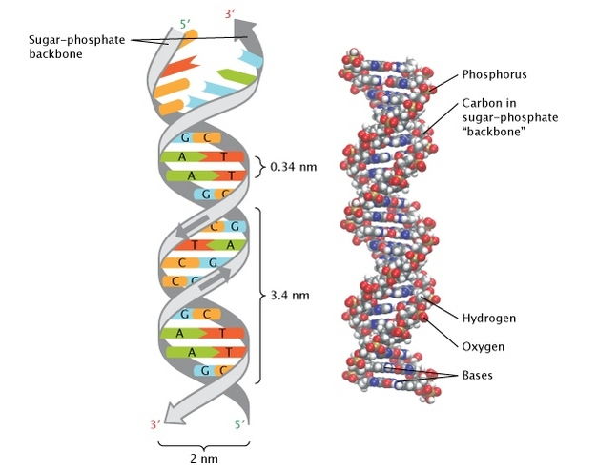
Two types of nucleic acids (found in living systems)
Deoxyribonucleic Acid (DNA)
DNA acts as the genetic material/genome in most of the organisms.
DNA is a long polymer of deoxyribonucleotides.
The length of DNA is usually determined by base pairs (number of pair of nucleotide).
Each organism has its unique length of DNA ;
Ribonucleic acid (RNA)
RNA is genetic material in retroviruses (Tobacco Mosaic viruses, HIV, etc.).
RNA is a long polymer of Ribonucleotides.
RNA mostly functions as;
messenger,
Adapter (tRNA),
structural, and
catalytic molecule.
Organism | Length of DNA
Φ174 (bacteriophage) | 5386 nucleotides
Lambda phage (Bacteriophage ) | 48502 base pairs (bp)
Escherichia coli | 4.6 × 10⁶ bp
human DNA (haploid content ) | 3.3 × 10⁹ bp
Notes:
In RNA, every nucleotide residue has an additional –OH group present at 2' -position in the ribose.
Also, in RNA the uracil is found at the place of thymine (5-methyl uracil, another chemical name for thymine).

Slide 4
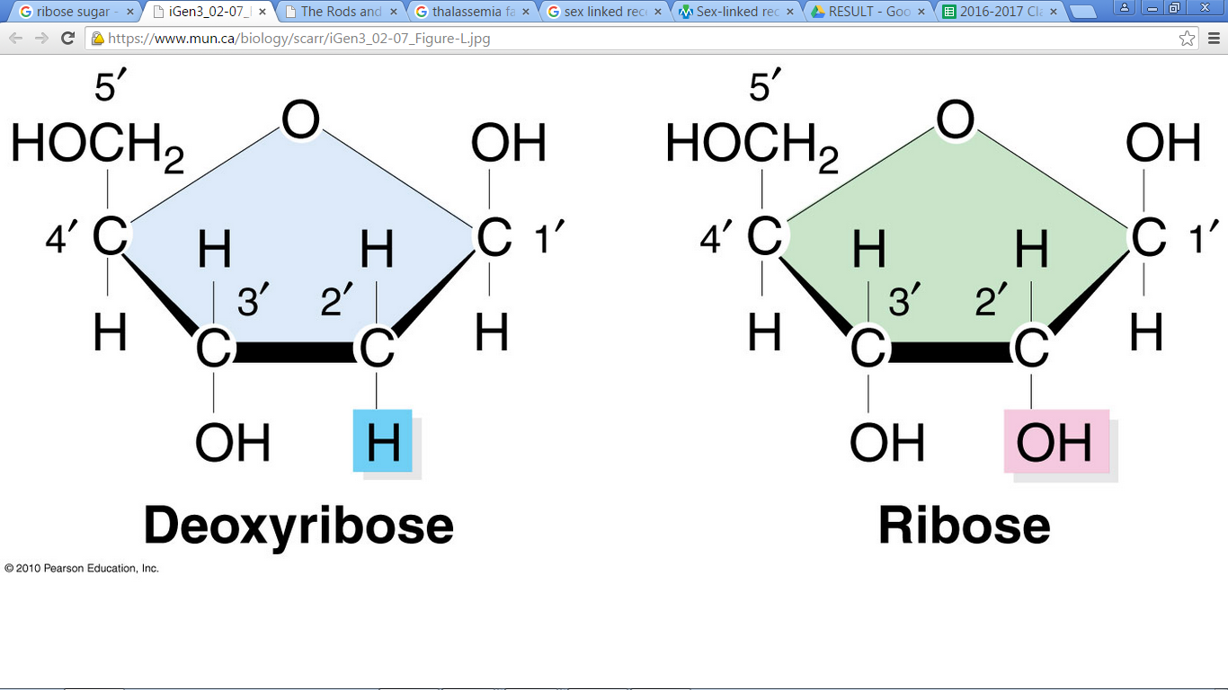
Nucleoside
Structural composition of of nucleotide
A phosphate group
PO₄³⁻
A nitrogenous base
A pentose sugar
Ribose
(in RNA)
Deoxyribose
(in DNA)
Purines
Pyrimidines
Adenine (A)
Guanine (G)
Cytosine (C)
[common for both DNA and RNA]
Thymine (T)
[present in DNA]
Uracil (U)
[present in RNA at the place of Thymine]

Slide 5
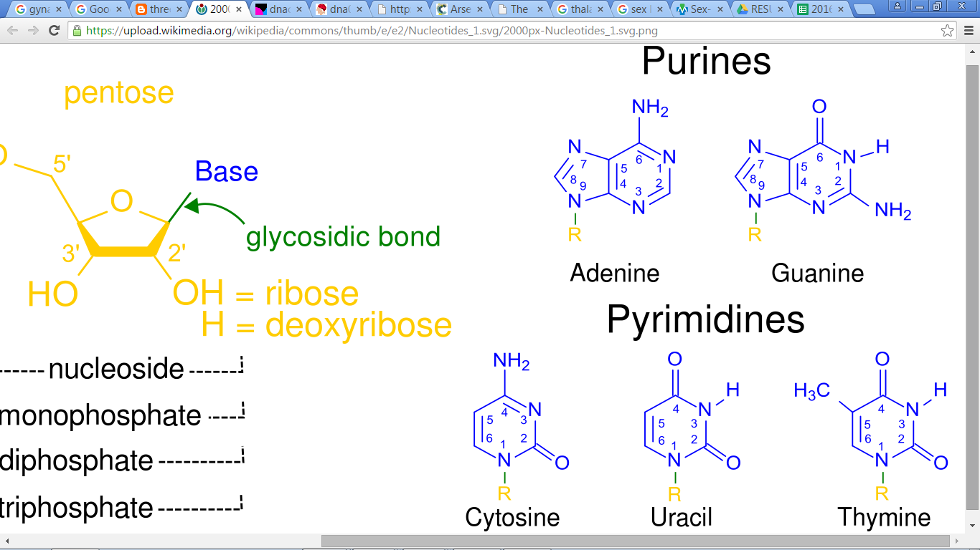
Nitrogenous Bases

Slide 6
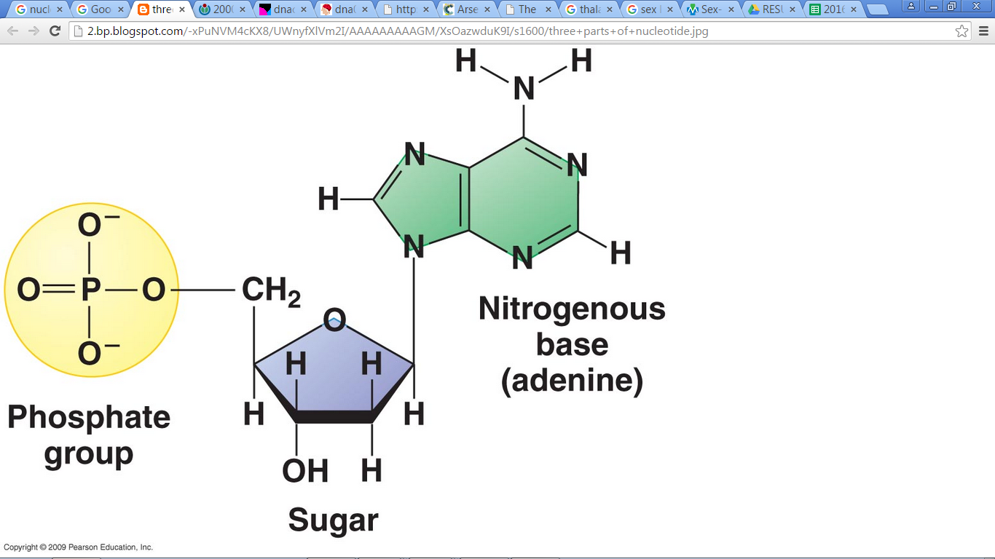
Linkages in three parts of Nucleotide
A nitrogenous base is linked to the pentose sugar through a N-glycosidic linkage to form a nucleoside.
Phosphate group (PO₄³⁻) is linked to 5'-OH of a nucleoside through phosphoester linkage
Phosphoester linkage
N-glycosidic linkage
Nucleoside
Notes:
Phosphoester bond: bond between the phosphorous atom of a phosphate group and an oxygen atom.
Phosphodiester bonds consist of two phosphoester bonds between a phosphate group and two oxygen atoms.

Slide 7
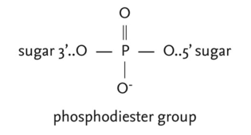
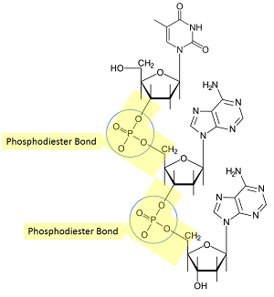
Phosphodiester linkage
Two nucleotides are linked through 3'-5' phosphodiester linkage to form a dinucleotide
Notes:
A phosphodiester bond occurs when exactly two of the hydroxyl groups in phosphoric acid react with hydroxyl groups on other molecules to form two ester bonds.
When a phosphate group is linked to 5'-OH of a nucleoside through phosphoester linkage, a corresponding nucleotide (or deoxynucleotide depending upon the type of sugar present) is formed.
Two nucleotides are linked through 3'-5' phosphodiester linkage to form a dinucleotide.
More nucleotides can be joined in such a manner to form a polynucleotide chain.

Slide 8
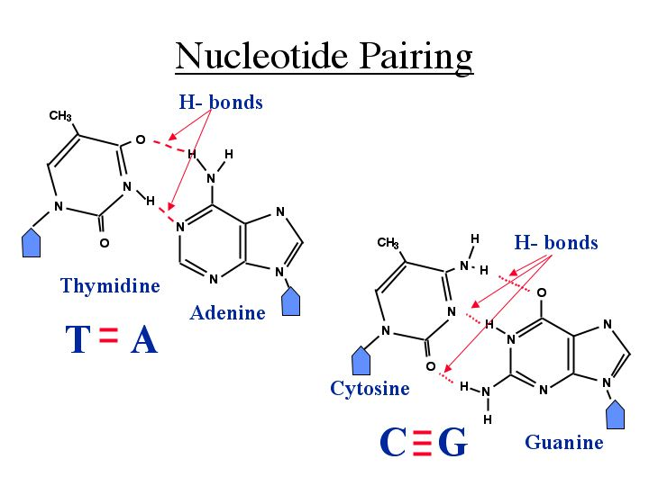

Slide 9
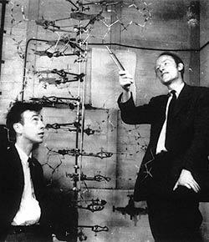
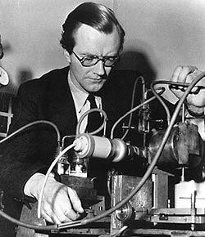
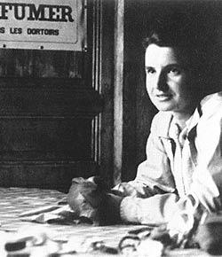
History: Structure of Polynucleotide Chain
1869: Friedrich Meischer discovered DNA as an acidic substance in nucleus of cell.
He named it as ‘Nuclein’.
Rosalind Franklin and Maurice Wilkins produced crystallised DNA X-ray diffraction data.
In 1953, James Watson and Francis Crick proposed Double Helix model of DNA by using their data.
James Watson and Francis Crick with their DNA model at the Cavendish Laboratories in 1953
Maurice Wilkins with X-ray crystallographic equipment about 1954.
Rosalind Franklin (Female) in Paris
Notes:
DNA as an acidic substance present in nucleus was first identified by Friedrich Meischer in 1869.
He named it as ‘Nuclein’.
However, due to technical limitation in isolating such a long polymer intact, the elucidation of structure of DNA remained elusive for a very long period of time.
DNA as an acidic substance present in nucleus was first identified by Friedrich Meischer in 1869.
He named it as ‘Nuclein’.
In 1953 that James Watson and Francis Crick, based on the X-ray diffraction data produced by Maurice Wilkins and Rosalind Franklin, proposed a very simple but famous Double Helix model for the structure of DNA.

Slide 10
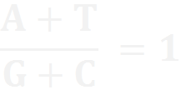
Double Helix model of DNA
Double helix model of DNA was based on;
Complementary base pairing between the two strands of polynucleotide chains i.e Adenine pairs with Thymine by two Hydrogen bonds whereas Guanine pairs with Cytosine by three hydrogen bonds.
The observation of Erwin Chargaff (Chargaff rule)
For a double stranded DNA, the ratio between adenine and thymine and guanine and cytosine are constant and equals one.
Notes:
parental DNA acts as a template for synthesis of a new strand, the two double stranded DNA (let us call them as daughter DNA) thus, produced would be identical to the parental DNA molecule.

Slide 11
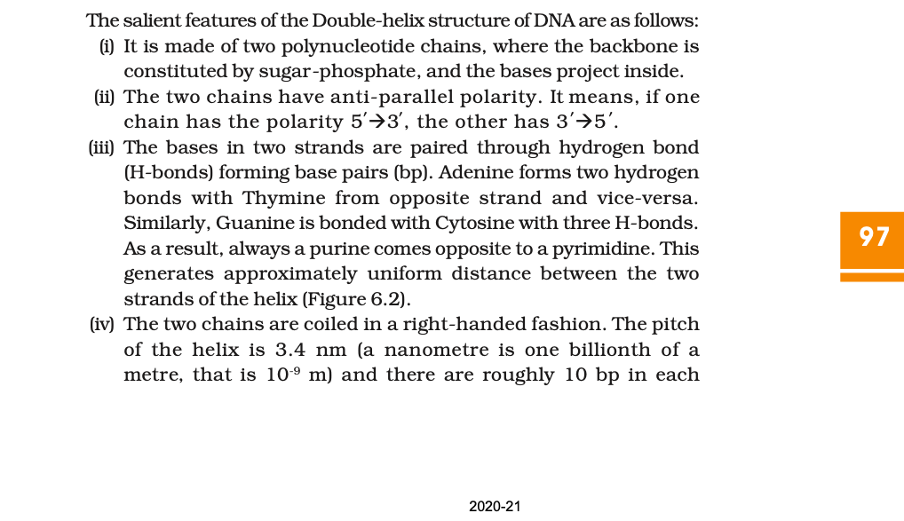
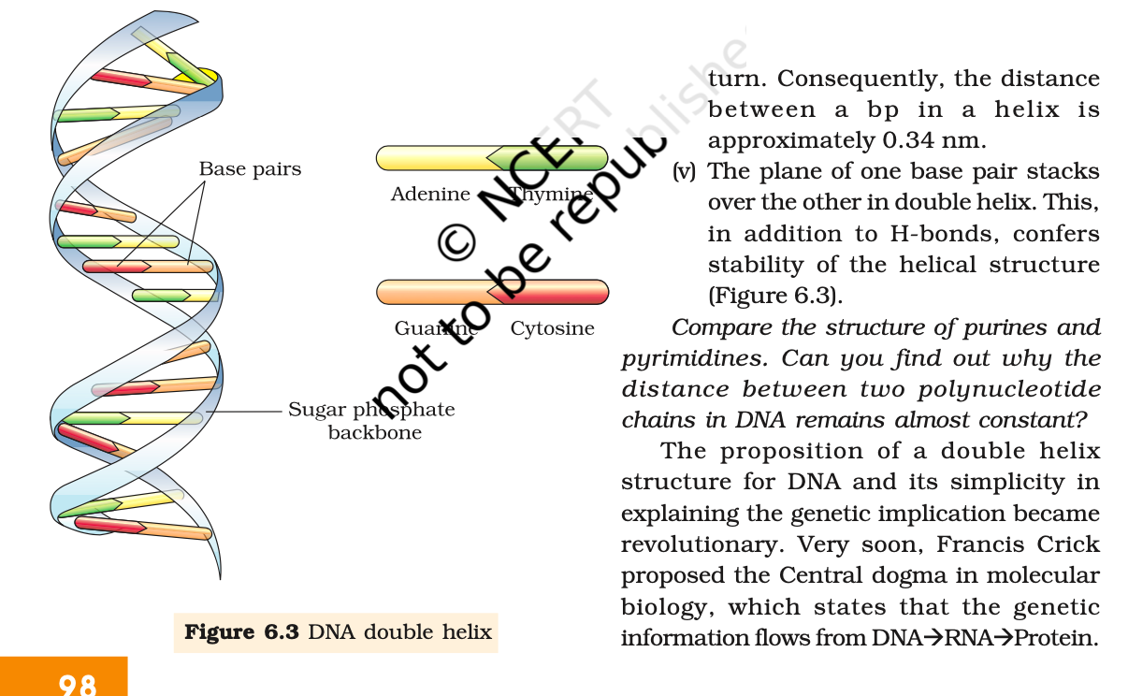
Salient features of the double-helix structure of DNA proposed by Watson and Crick
Open page number 97 and try to recall the structure of DNA
Notes:
pitch(distance between helix)
DNA is made of two polynucleotide chains, where the backbone is constituted by sugar-phosphate, and the bases project inside.
The two chains have anti-parallel polarity. It means, if one chain has the polarity 5'→3', the other has 3' → 5' .
The bases in two strands are paired through hydrogen bond (H-bonds) forming base pairs (bp). Adenine forms two hydrogen bonds with Thymine from opposite strand and vice-versa. Similarly, Guanine is bonded with Cytosine with three H-bonds.As a result, always a purine comes opposite to a pyrimidine. This generates approximately uniform distance between the two strands of the helix
The two chains are coiled in a right-handed fashion.
The pitch of the helix is 3.4 nm (a nanometre is one billionth of a metre, that is 10-9 m) and there are roughly 10 bp in each turn. Consequently, the distance between a bp in a helix is approximately equal to 0.34 nm.
The plane of one base pair stacks over the other in double helix. This, in addition to H-bonds, confers stability of the helical structure

Slide 12
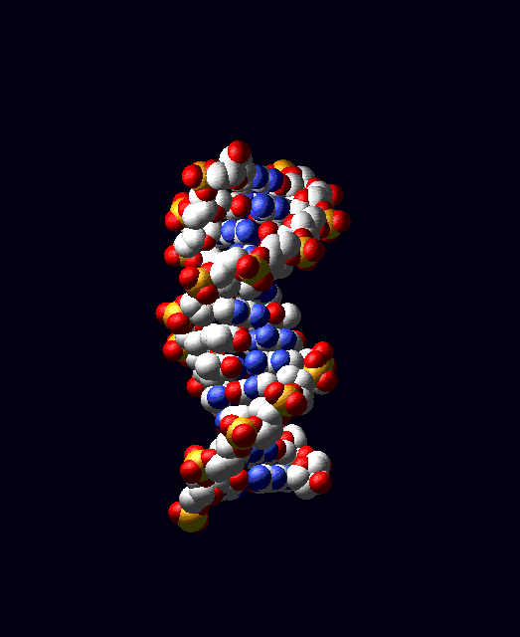

Slide 13
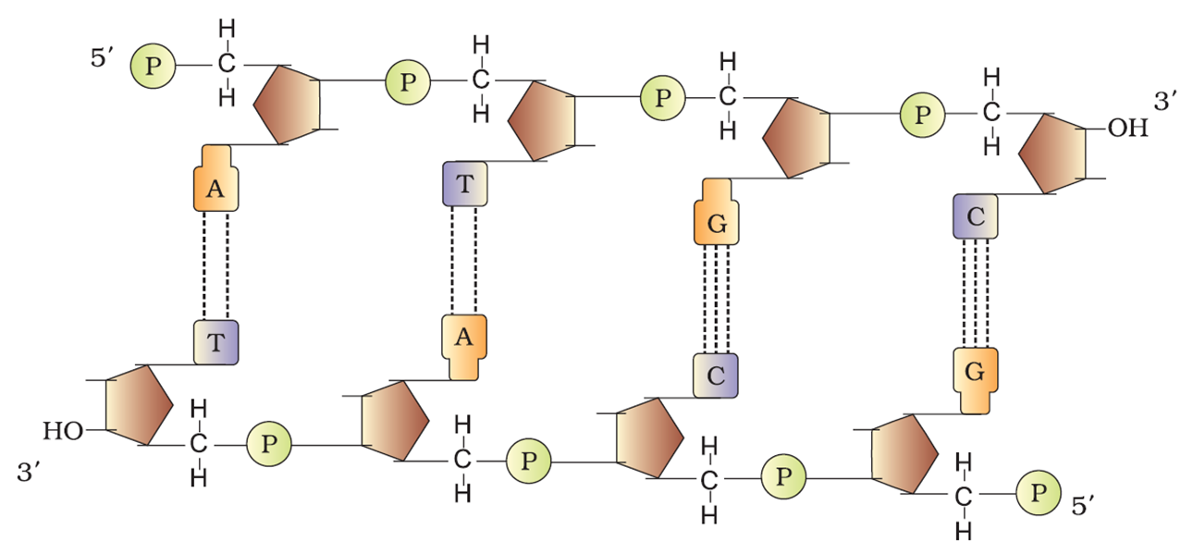
Structure of DNA Polynucleotide Chain
5’-end of polynucleotide chain
3' -end of the polynucleotide chain
0.34 nm (0.34×10^{–9} m)
Free phosphate moiety
3'-OH group
3' -end of the polynucleotide chain
Sugar and phosphates backbone
5’-end of polynucleotide chain
Notes:
A polymer thus formed has at one end a free phosphate moiety (a distinct part of a large molecule) at 5'-end of ribose sugar, which is referred to as 5’-end of polynucleotide chain.
Similarly, at the other end of the polymer the ribose has a free 3'-OH group which is referred to as 3' -end of the polynucleotide chain.
The backbone in a polynucleotide chain is formed due to sugar and phosphates.
The nitrogenous bases linked to sugar moiety project from the backbone

Slide 14
Packaging of DNA Helix
Inclass exercise:
Question: Number of nitrogenous base pairs in a mammalian cell is 6.6 × 10⁹ bp. What is the length of the DNA in meters?
[Hint: Distance between two consecutive base pairs of the DNA = 0.34 × 10-⁹m/bp)]
Answer: 6.6 × 10⁹ bp × 0.34 × 10⁻⁹ m/bp = 2.2 metres.
An interesting fact
Dimension of a typical nucleus = 10^{–6} m [approximately], ˂ 2.2 m
How is 2.2 metres long polymer packaged in the nucleus 10^{–6} m (˂ 2.2 m) of cell?
Notes:
If the length of DNA double helix in a typical mammalian cell is calculated (simply by multiplying the total number of bp with distance between two consecutive bp, that is, 6.6 × 109 bp × 0.34 × 10-9m/bp), it comes out to be approximately 2.2 metres. A length that is far greater than the dimension of a typical nucleus (approximately 10–6 m).
How is such a long polymer packaged in a cell?

Slide 15
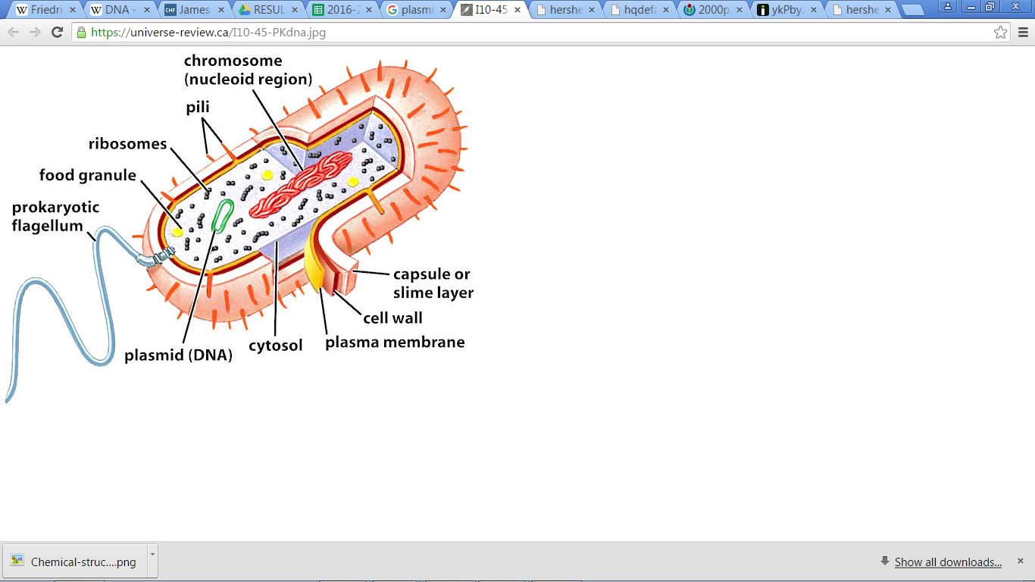
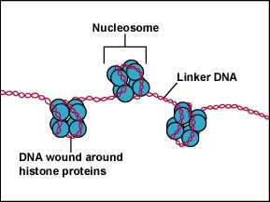
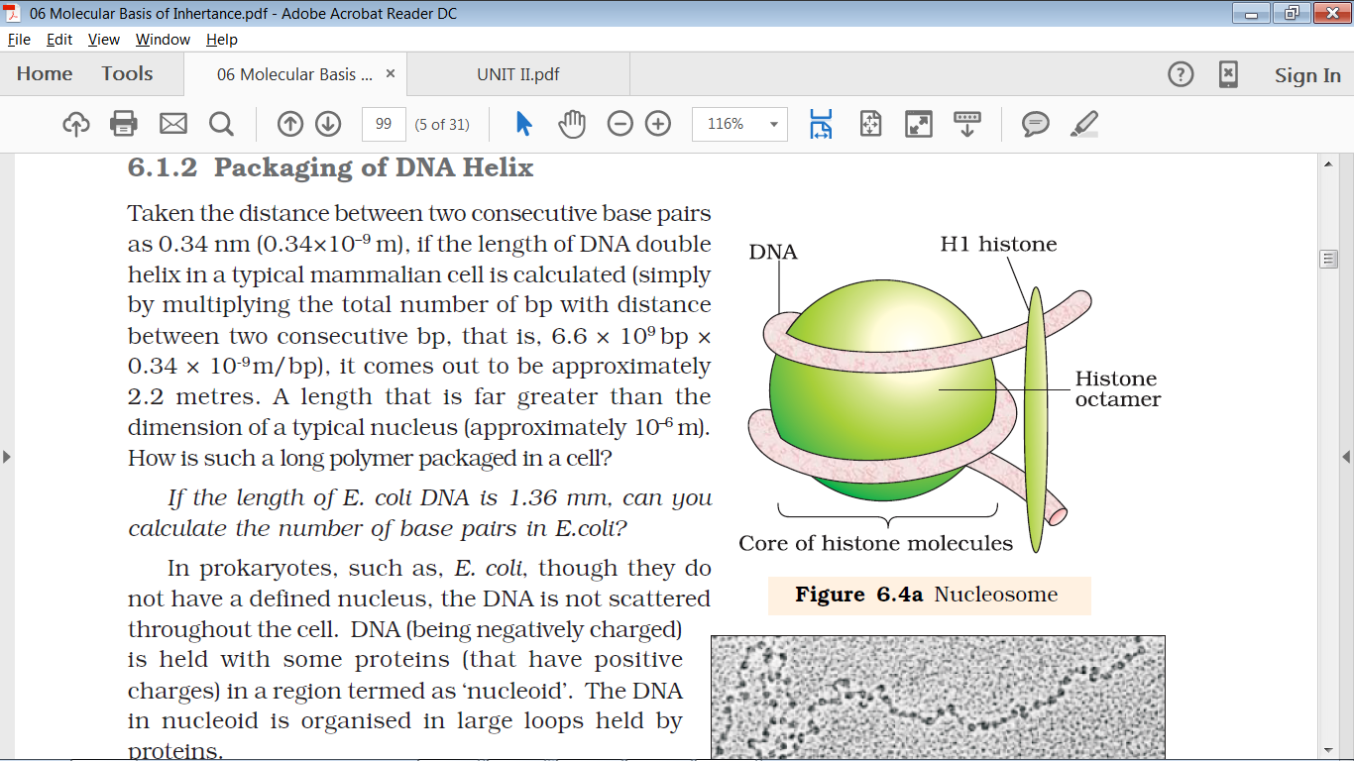
In prokaryotes (like E. coli)
Packaging of DNA Helix
In eukaryotes
Negatively charged DNA is held with some positively charged non-histone proteins (like polyamines) in the region of nucleoid.
Negatively charged DNA is held with positively charged histone proteins (to form Nucleosome) + Non-histone Chromosomal (NHC) proteins for higher level packaging.
Histones are positively charged due to rich in basic amino acid residues lysines and arginines
Nucleosome
Notes:
Coiled, recoiled, folded and compacted

Slide 16
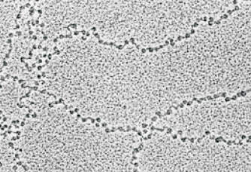
Nucleosome
The negatively charged DNA (200 bp approx.) is wrapped around the positively charged histone octamer to form a nucleosome.
Nucleosomes repeated to form chromatin.
The nucleosomes in chromatin are seen as ‘beads-on-string’ structure when viewed under electron microscope
The nucleosome requires Non-histone Chromosomal (NHC) proteins for higher level packaging.
EM picture: ‘Beads-on-String’ like structure of nucleosome
Beads-on-String of rosary
Notes:
The negatively charged DNA (200 bp approx.) is wrapped around the positively charged histone octamer to form a nucleosome.
Nucleosomes constitute the repeating unit of chromatin [thread-like stained (coloured) bodies seen in nucleus].
The nucleosomes in chromatin are seen as ‘beads-on-string’ structure when viewed under electron microscope

Slide 17
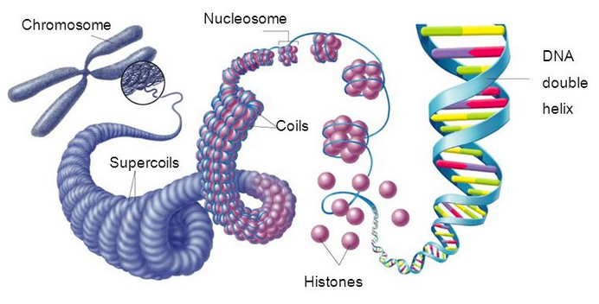
Eukaryotic chromosome = DNA + Histone protein + Non-histone chromosomal protein

Slide 18
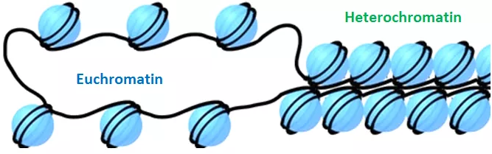
Chromatin
Euchromatin | Heterochromatin
Loosely packed chromatin in the nucleus (stains light)
More densely packed chromatin
(stains dark)
Transcriptionally active chromatin.
Transcriptionally inactive
Notes:
The beads-on-string structure in chromatin is packaged to form chromatin fibers that are further coiled and condensed at metaphase stage of cell division to form chromosomes. The packaging of chromatin at higher level requires additional set of proteins that collectively are referred to as Non-histone Chromosomal (NHC) proteins. In a typical nucleus, some region of chromatin are loosely packed (and stains light) and are referred to as euchromatin. The chromatin that is more densely packed and stains dark are called as Heterochromatin. Euchromatin is said to be transcriptionally active chromatin, whereas heterochromatin is inactive.

Slide 19
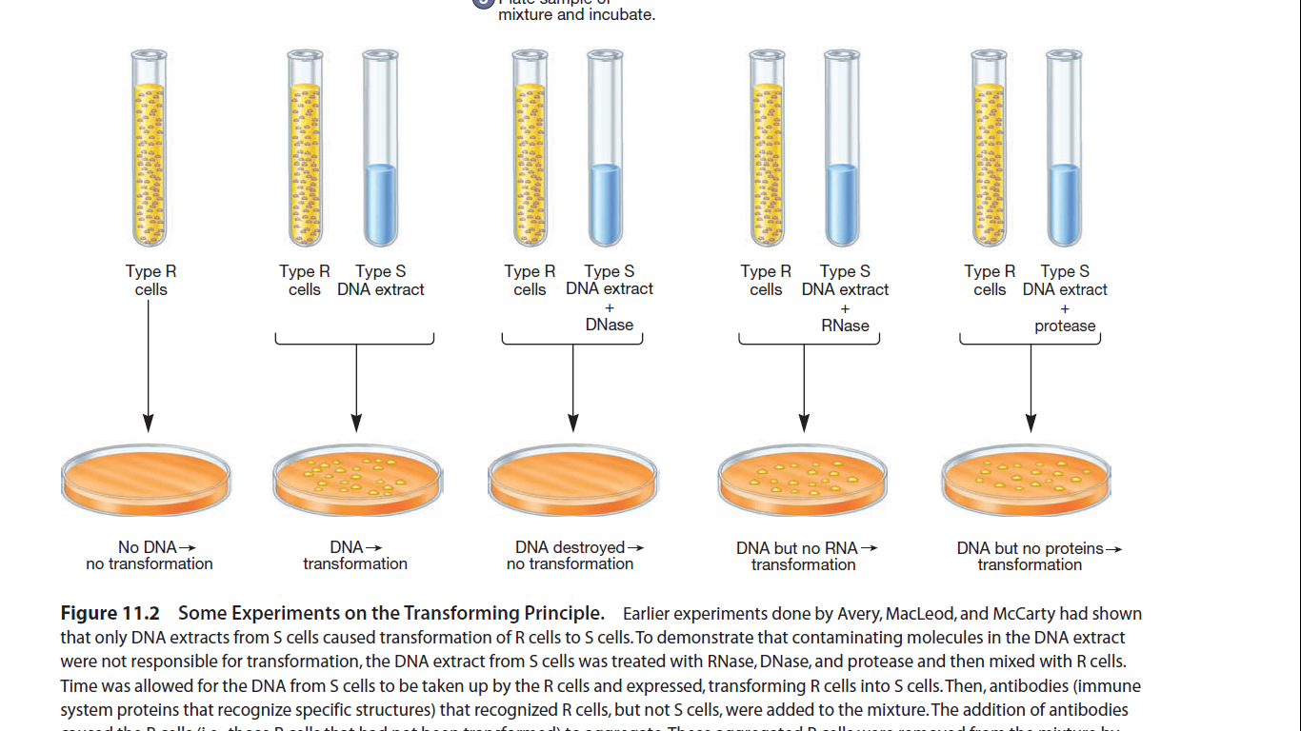
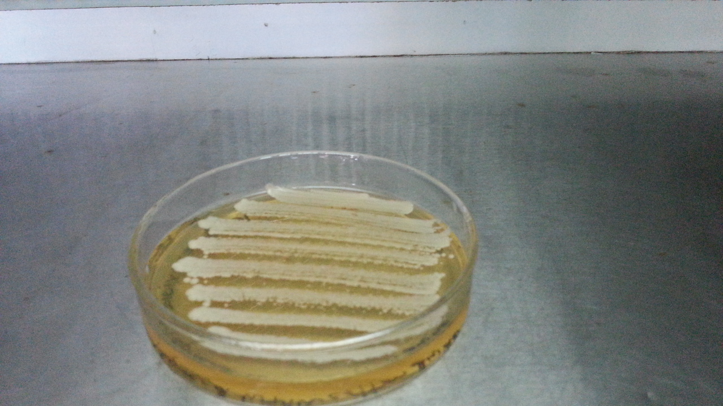
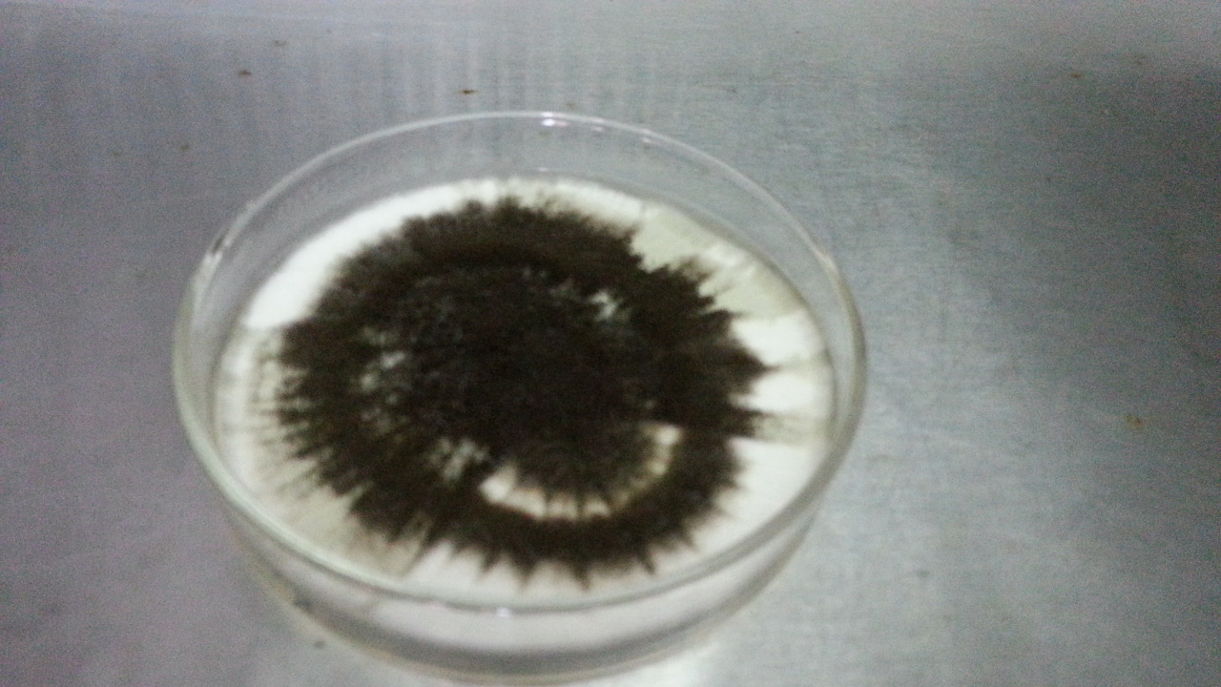
Picture comprehension

Slide 20
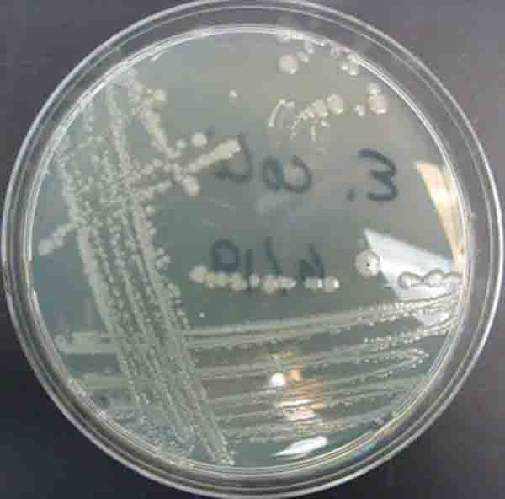
Picture comprehension

Slide 21
Summary; Scientists, test organisms used and their contribution
 | Years | Scientists | Test Organism | Contribution
 | 1869 | Friedrich Meischer |  | First identified DNA as an acidic substance present in nucleus and named it as ‘Nuclein’.
 |  | Maurice Wilkins and Rosalind Franklin. |  | Produced crystallised DNA X-ray diffraction data
 | 1953 | James Watson and Francis Crick |  | Proposed Double Helix model of DNA by using crystallised DNA X-ray diffraction data produced by Maurice Wilkins and Rosalind Franklin
In search for genetic material | 1928 | Frederick Griffith | Streptococcus pneumoniae Mouse/Mice | Transforming principle
 | 1933-44 | Oswald Avery, Colin MacLeod and Maclyn McCarty | Streptococcus pneumoniae | Concluded that DNA is hereditary material or biochemical nature of ‘transforming principle is DNA
 | 1952 | Alfred Hershey and Martha Chase | Bacteriophage E. coli | Proved that DNA is the genetic material.

Slide 22
The Search For Genetic Material
Transforming Principle
In 1928, Frederick Griffith conducted experiments with Streptococcus pneumoniae (bacterium responsible for pneumonia).
Experiment;
Grown Streptococcus pneumoniae (pneumococcus) on a culture plates
Smooth shiny colonies (S)
[bacteria possess mucous (polysaccharide) coat]
Rough colonies (R)
[bacteria don’t have mucous coat]
Isolated S strain bacteria
Injected heat killed S strain bacteria into live mouse
Isolated R strain bacteria
Injected S strain bacteria into live mouse
Injected Isolated R strain bacteria into live mouse
Injected heat killed S strain bacteria into live mouse
Mouse died
Injected heat killed S strain and R strain bacteria into live mouse
Mouse lives
Mouse lives
S strain bacteria is
VIRULENT/INFECTIOUS
R strain bacteria is
NON VIRULENT/AVIRULENT
Mouse died
Conclusion: Some ‘transforming principle’ transferred from the heat-killed S strain, had enabled the R strain to synthesise a smooth polysaccharide coat and become virulent

Slide 23
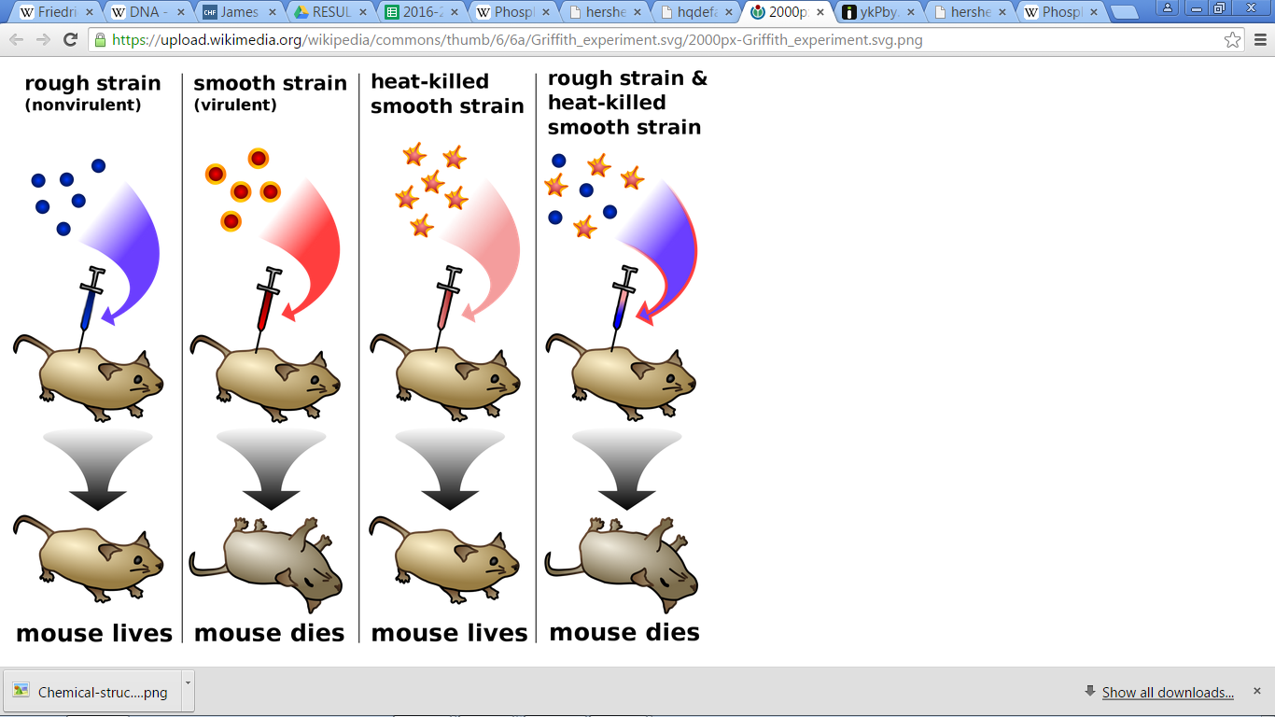
Experiment of Frederick Griffith
What conclusion can you draw from the experiment?

Slide 24
Transforming Principle of Frederick Griffith
Conclusion:
R strain bacteria was transformed by the heat-killed S strain bacteria.
Some ‘transforming principle’, transferred from the heat-killed S strain, had enabled the R strain to synthesise a smooth polysaccharide coat and become virulent.
This must be due to the transfer of the genetic material.
However, Griffith was not able to know the biochemical nature of genetic material.

Slide 25
Biochemical Characterisation of Transforming Principle
Earlier, the genetic material was thought to be a protein.
In 1933-44 , Oswald Avery, Colin MacLeod and Maclyn McCarty worked to determine the biochemical nature of ‘transforming principle’ in Griffith's experiment as follows;
Purified biochemicals (proteins, DNA, & RNA) from the heat killed S cells
Checked for the biochemical responsible for transforming R cell into virulent S cells
R cells didn’t produced S cells (Not transformed)
Protein extract of heat killed S cells + R cells = No S cells (Not transformed)
RNA extract of heat killed S cells + R cells = No S cells (Not transformed)
DNA extract of heat killed S cells + R cells = S cells (Transformed)
DNA extract of heat killed S cells + R cells + Proteases = S cells (Transformed)
DNA extract of heat killed S cells + R cells + RNases = S cells (Transformed)
DNA extract of heat killed S cells + R cells + DNases = No S cells (Not transformed)
Concluded that DNA is the hereditary material
Not all biologists were convinced.
Notes:
Earlier, the genetic material was thought to be a protein.
In 1933-44 , Oswald Avery, Colin MacLeod and Maclyn McCarty worked to determine the biochemical nature of ‘transforming principle’ in Griffith's experiment.
They purified biochemicals (proteins, DNA, RNA, etc.) from the heat-killed S cells to see which ones could transform live R cells into S cells.
They discovered that DNA alone from S bacteria caused R bacteria to become transformed.
They also discovered that protein-digesting enzymes (proteases) and RNA-digesting enzymes (RNases) did not affect transformation, so the transforming substance was not a protein or RNA. Digestion with DNase did inhibit transformation, suggesting that the DNA caused the transformation. They concluded that DNA is the hereditary material, but not all biologists were convinced.

Slide 26
Experiment of Oswald Avery, Colin MacLeod and Maclyn McCarty on ‘Biochemical nature of Transforming Principle’

Slide 27
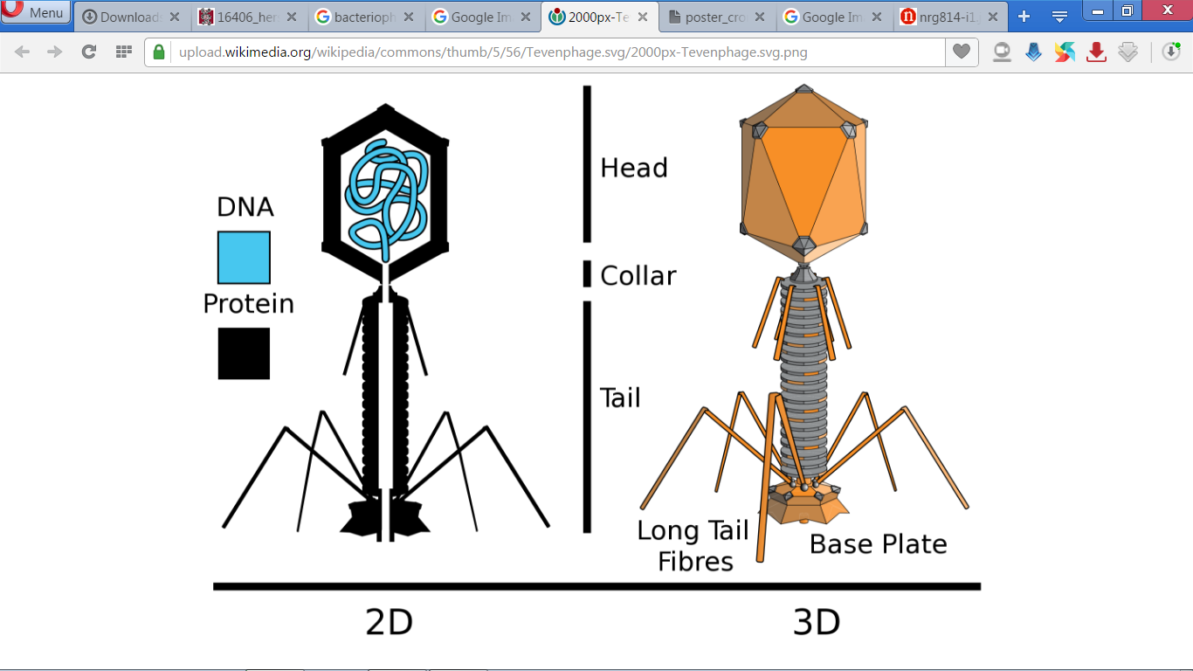
BACTERIOPHAGE

Slide 28
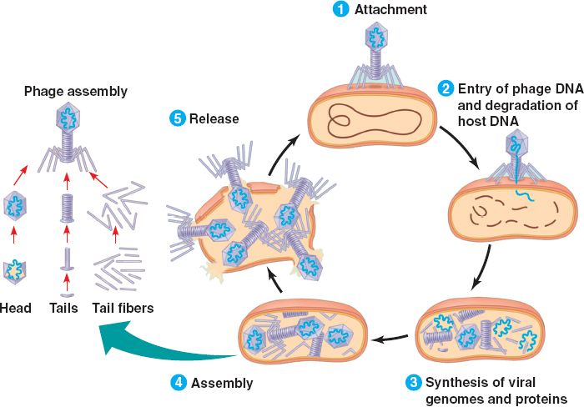
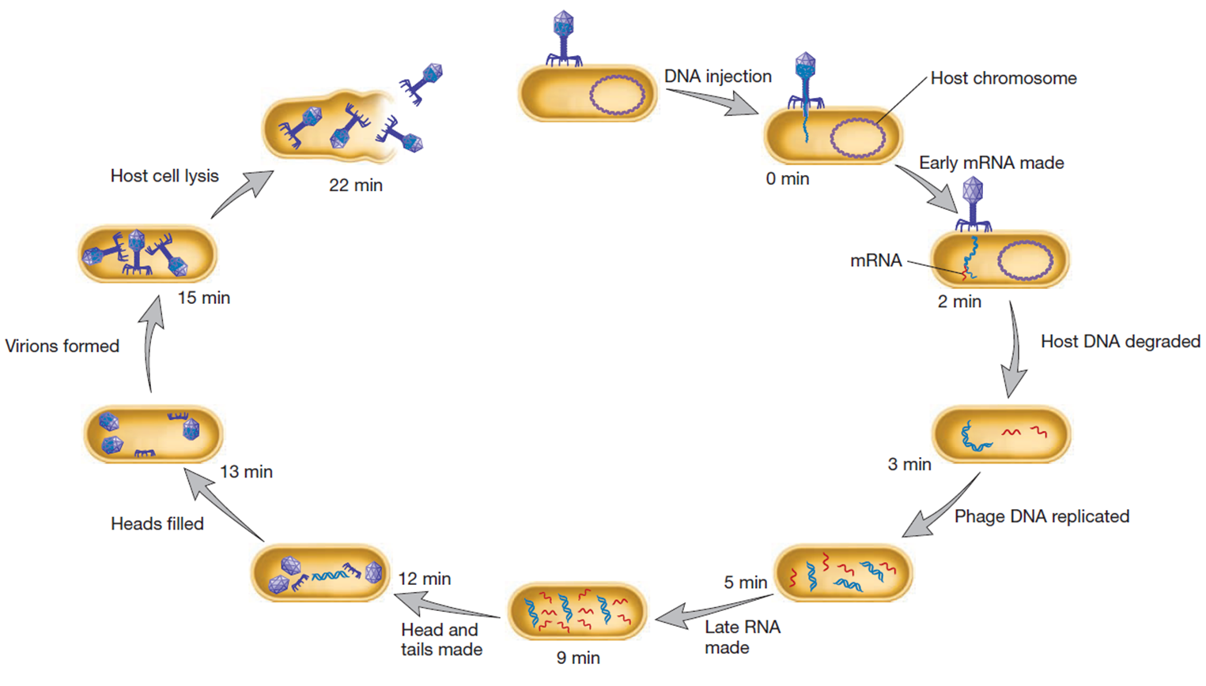
The Life Cycle of Bacteriophage T4
Notes:
The bacteriophage attaches to the bacteria and its genetic material then enters the bacterial cell. The bacterial cell treats the viral genetic material as if it was its own and subsequently manufactures more virus particles.

Slide 29
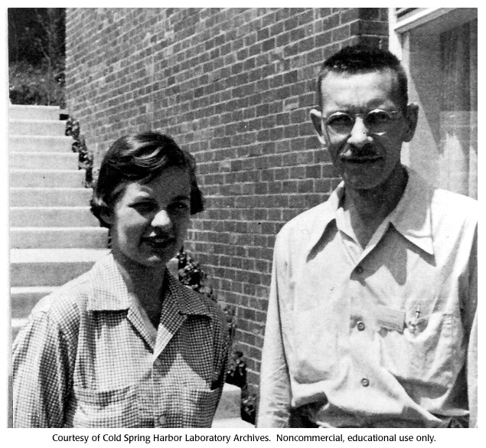
The Genetic Material is DNA
Alfred Hershey and Martha Chase (1952) researched on bacteriophages and proved that DNA is the genetic material.
Radio labeled DNA with radioisotope ³²P and protein with radioisotope ³⁵S.
Worked to discover whether it was protein or DNA from the viruses that entered the bacteria.
It was found that DNA from the viruses entered the bacteria.
Martha Chase
Alfred Hershey

Slide 30
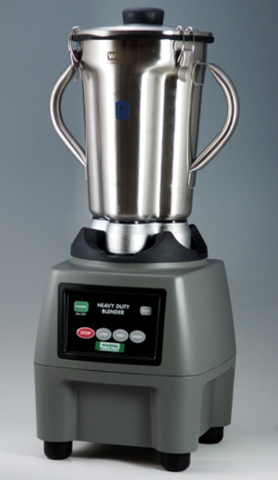
Blender

Slide 31
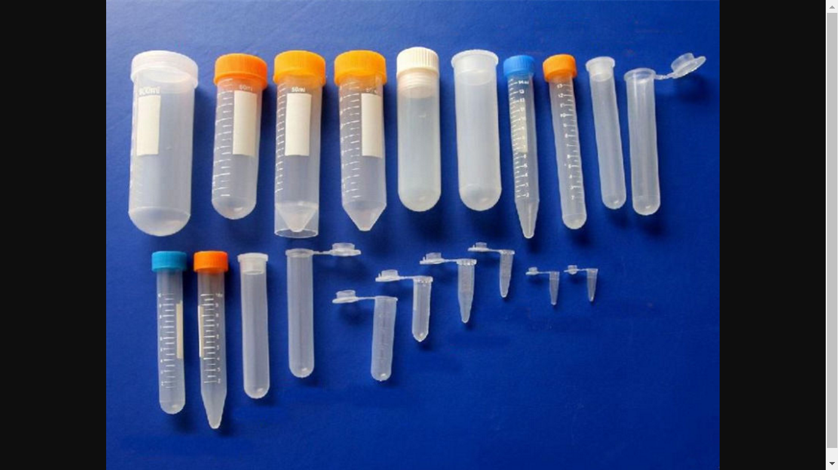
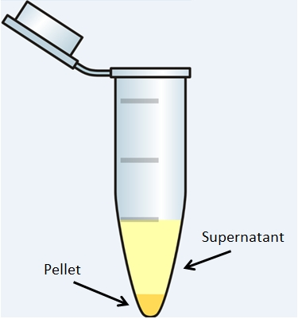
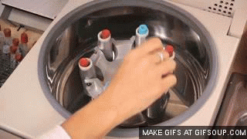
Centrifuge tubes
Centrifuge

Slide 32
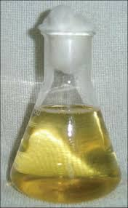
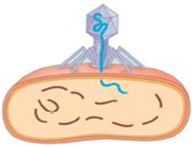
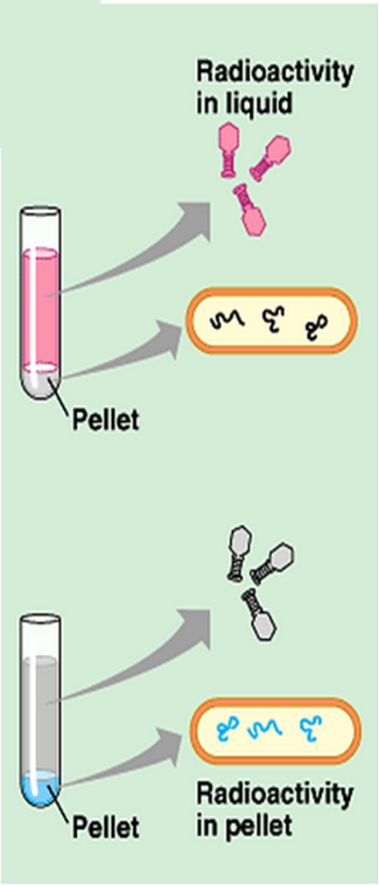
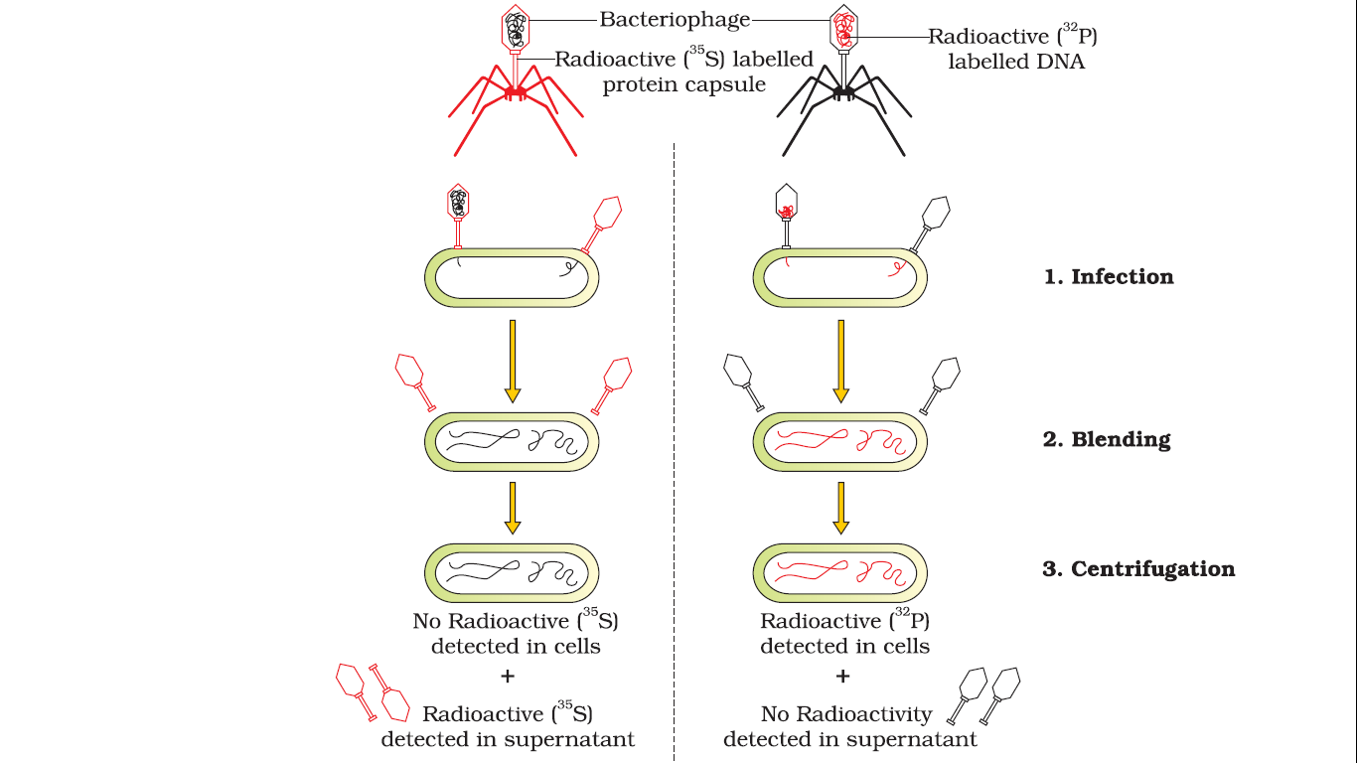
Hershey and Chase’s experiment
Medium containing radioactive sulfur (³⁵S)
³⁵S
Liquid medium with E. Coli
Centrifuge
Notes:
Hershey and Chase worked to discover whether it was protein or DNA from the viruses that entered the bacteria.
They grew some viruses on a medium that contained radioactive phosphorus and some others on medium that contained radioactive sulfur.
Viruses grown in the presence of radioactive phosphorus contained radioactive DNA but not radioactive protein because DNA contains phosphorus but protein does not.
Similarly, viruses grown on radioactive sulfur contained radioactive protein but not radioactive DNA because DNA does not contain sulfur.
Radioactive phages were allowed to attach to E. coli bacteria. Then, as the infection proceeded, the viral coats were removed from the bacteria by agitating them in a blender. The virus particles were separated from the bacteria by spinning them in a centrifuge.

Slide 33
Hershey and Chase’s experiment
Grew bacteriophages in medium that contained radioactive sulfur (³⁵S)
New bacteriophages contained radioactive protein but not radioactive DNA
Radioactive phages were allowed to attach to E. Coli and infect
Coats were removed from the bacteria by agitating them in a blender just after infection
Virus particles were separated from the bacteria by spinning them in a centrifuge
Observed and interpreted
Notes:
Hershey and Chase worked to discover whether it was protein or DNA from the viruses that entered the bacteria.
They grew some viruses on a medium that contained radioactive phosphorus and some others on medium that contained radioactive sulfur.
Viruses grown in the presence of radioactive phosphorus contained radioactive DNA but not radioactive protein because DNA contains phosphorus but protein does not.
Similarly, viruses grown on radioactive sulfur contained radioactive protein but not radioactive DNA because DNA does not contain sulfur.
Radioactive phages were allowed to attach to E. coli bacteria. Then, as the infection proceeded, the viral coats were removed from the bacteria by agitating them in a blender. The virus particles were separated from the bacteria by spinning them in a centrifuge.

Slide 34
Hershey and Chase’s experiment
³²P
Medium containing radioactive sulfur (³²P)
Liquid medium with E. Coli
Centrifuge
Notes:
Hershey and Chase worked to discover whether it was protein or DNA from the viruses that entered the bacteria.
They grew some viruses on a medium that contained radioactive phosphorus and some others on medium that contained radioactive sulfur.
Viruses grown in the presence of radioactive phosphorus contained radioactive DNA but not radioactive protein because DNA contains phosphorus but protein does not.
Similarly, viruses grown on radioactive sulfur contained radioactive protein but not radioactive DNA because DNA does not contain sulfur.
Radioactive phages were allowed to attach to E. coli bacteria. Then, as the infection proceeded, the viral coats were removed from the bacteria by agitating them in a blender. The virus particles were separated from the bacteria by spinning them in a centrifuge.

Slide 35
Hershey and Chase’s experiment
Grew bacteriophages in a medium that contained radioactive phosphorus (³²P).
New bacteriophages contained radioactive DNA but not radioactive protein
Radioactive phages were allowed to attach to E. Coli
Coats were removed from the bacteria by agitating them in a blender just after infection
Virus particles were separated from the bacteria by spinning them in a centrifuge
Observed and interpreted
Notes:
Hershey and Chase worked to discover whether it was protein or DNA from the viruses that entered the bacteria.
They grew some viruses on a medium that contained radioactive phosphorus and some others on medium that contained radioactive sulfur.
Viruses grown in the presence of radioactive phosphorus contained radioactive DNA but not radioactive protein because DNA contains phosphorus but protein does not.
Similarly, viruses grown on radioactive sulfur contained radioactive protein but not radioactive DNA because DNA does not contain sulfur.
Radioactive phages were allowed to attach to E. coli bacteria. Then, as the infection proceeded, the viral coats were removed from the bacteria by agitating them in a blender. The virus particles were separated from the bacteria by spinning them in a centrifuge.

Slide 36
The Hershey-Chase experiment

Slide 37
Summary
 | Years | Scientists | Test Organism | Contribution
 | 1869 | Friedrich Meischer |  | First identified DNA as an acidic substance present in nucleus and named it as ‘Nuclein’.
 |  | Maurice Wilkins and Rosalind Franklin. |  | Produced crystallised DNA X-ray diffraction data
 | 1953 | James Watson and Francis Crick |  | Proposed Double Helix model of DNA by using crystallised DNA X-ray diffraction data produced by Maurice Wilkins and Rosalind Franklin
In search for genetic material | 1928 | Frederick Griffith | Streptococcus pneumoniae Mouse/Mice | Transforming principle
 | 1933-44 | Oswald Avery, Colin MacLeod and Maclyn McCarty | Streptococcus pneumoniae | Concluded that DNA is hereditary material or biochemical nature of ‘transforming principle is DNA
 | 1952 | Alfred Hershey and Martha Chase | Bacteriophage E. coli | Proved that DNA is the genetic material.

Slide 38
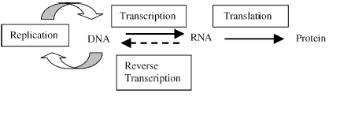
Central dogma in molecular biology
Soon after the proposition of double helix structure for DNA, Francis Crick proposed the Central dogma(doctrine/principle) in molecular biology.
Central dogma in molecular biology states that;
the genetic information flows from DNA→RNA → Protein.
In retroviruses the flow of information is in reverse direction i.e. from RNA to DNA.
In some viruses
Notes:
The proposition of a double helix structure for DNA and its simplicity in explaining the genetic implication became revolutionary.
Very soon, Francis Crick proposed the Central dogma in molecular biology, which states that the genetic information flows from DNA→RNA → Protein.
In some viruses the flow of information is in reverse direction, that is, from RNA to DNA.

Slide 39
Two steps of gene expression (Central Dogma of molecular biology)
3'
5'
A G C T A G C T A G C T G C T A G C A G C T G C T
DNA Helix
(Polymer of deoxyribonucleotide)
T C G A T C G A T C G A C G A T C G T C G A C G A
5'
3'
1. Transcription
mRNA
(Polymer of ribonucleotide)
U C G A U C G A U C G A C G A U C G U C G A C G A
2. Translation
Protein
(Polymer of amino acids)

Slide 40
Properties of Genetic Material
A molecule that can act as a genetic material must fulfill the following criteria:
It should be able to generate its replica(Replication).
It should be chemically and structurally stable.
It should provide the scope for slow changes (mutation) that are required for evolution.
It should be able to express itself in the form of 'Mendelian Characters’.

Slide 41
DNA is a better genetic material compared to RNA. Justify
DNA is chemically less reactive and structurally more stable when compared to RNA being double stranded.
Two strands of DNA being complementary if separated by heating come together, when appropriate conditions are provided.
Presence of thymine at the place of uracil also confers additional stability to DNA.
In RNA, 2‘ -OH group present at every nucleotide is a reactive group and makes RNA labile* and easily degradable.
RNA is known to be catalytic, hence reactive.
Therefore, among the two nucleic acids, the DNA is a better genetic material.
*Readily undergoing change

Slide 42
What do you think is the first genetic material?
RNA was the first genetic material
DNA has evolved from RNA with chemical modifications that make it more stable.

Slide 43
REPLICATION
Replication is the process of copying DNA into DNA.
Watson and Crick had proposed a semiconservative replication of DNA.
‘‘It has not escaped our notice that the specific pairing we have postulated immediately suggests a possible copying mechanism for the genetic material’’
Watson and Crick, 1953
James Watson and Francis Crick with their DNA model at the Cavendish Laboratories in 1953

Slide 44
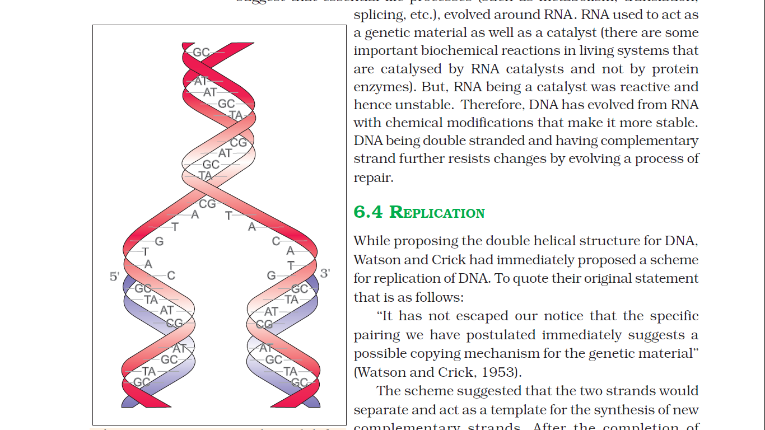
Watson-Crick model for semiconservative DNA replication
Parental DNA
One parental DNA
Two separate strands of DNA
Template DNA
New complementary strands
Newly synthesised strands
Daughter DNA
Notes:
The two strands would separate and act as a template for the synthesis of new complementary strands.
After the completion of replication, each DNA molecule would have one parental and one newly synthesised strand.

Slide 45
The Experimental Proof for Watson-Crick model for semiconservative DNA replication
The semiconservative replication of DNA was shown first in Escherichia coli and subsequently in plants and human cells.
Matthew Meselson and Franklin Stahl (1958) proved that DNA replicates semiconservatively.

Slide 46
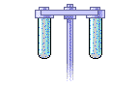
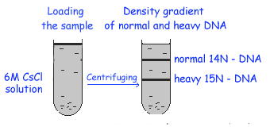
Lets Learn Together Better
Cesium chloride (CsCl) density gradient centrifuge
CsCl forms density gradient
Isotope Of Nitrogen
¹⁵N is the heavy isotope
¹⁴N is the light isotope
Notes:
Under high centrifugal force, a solution of cesium chloride (CsCl) molecules will dissociate.The heavy Cs⁺ atoms will be forced away from the center towards the outer end of the tube, but will at the same time diffuse back towards the top of the tube, thus forming a shallow density gradient.

Slide 47
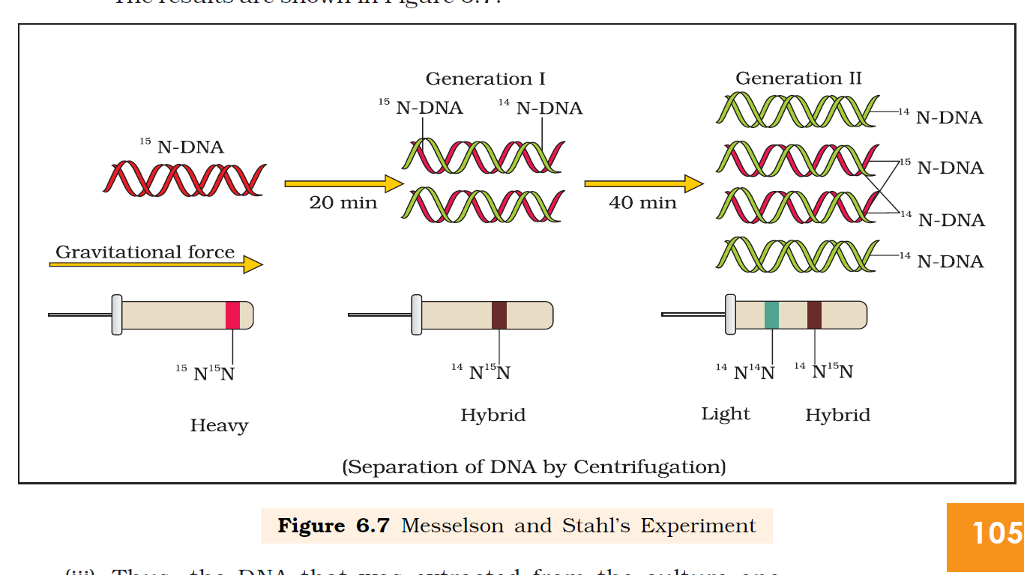
Meselson and Stahl’s Experiment
Grew E. coli in a medium containing ¹⁵NH₄Cl as the only nitrogen source for many generations
¹⁵N was incorporated into newly synthesised DNA of the E. coli
Extracted the DNA
Centrifuged the extracted DNA using Cesium chloride (CsCl) density gradient centrifuge(To distinguish heavy DNA molecule from the normal DNA)
Notes:
They grew E. coli in a medium containing ¹⁵NH4Cl (¹⁵N is the heavy isotope of nitrogen) as the only nitrogen source for many generations. The result was that 15N was incorporated into newly synthesised DNA (as well as other nitrogen containing compounds). This heavy DNA molecule could be distinguished from the normal DNA by centrifugation in a cesium chloride (CsCl) density gradient (Please note that 15N is not a radioactive isotope, and it can be separated from 14N only based on densities).
Then they transferred the cells into a medium with normal 14NH4Cl and took samples at various definite time intervals as the cells multiplied, and extracted the DNA that remained as double-stranded helices. The various samples were separated independently on CsCl gradients to measure the densities of DNA
Thus, the DNA that was extracted from the culture one generation after the transfer from 15N to 14N medium [that is after 20 minutes; E. coli divides in 20 minutes] had a hybrid or intermediate density. DNA extracted from the culture after another generation [that is after 40 minutes, II generation] was composed of equal amounts of this hybrid DNA and of ‘light’ DNA.
Very similar experiments involving use of radioactive thymidine to detect distribution of newly synthesised DNA in the chromosomes was performed on Vicia faba (faba beans) by Taylor and colleagues in 1958. The experiments proved that the DNA in chromosomes also replicate semiconservatively.

Slide 48
Continuation of Messelson and Stahl’s Experiment
Transferred the E. coli cells into a medium with normal ¹⁴NH₄Cl
Extracted the DNA at various time intervals (20’ & 40’) as the cells multiplied
These samples were separated independently using CsCl gradients centrifuge to measure the densities of DNA
Notes:
They grew E. coli in a medium containing ¹⁵NH4Cl (¹⁵N is the heavy isotope of nitrogen) as the only nitrogen source for many generations. The result was that 15N was incorporated into newly synthesised DNA (as well as other nitrogen containing compounds). This heavy DNA molecule could be distinguished from the normal DNA by centrifugation in a cesium chloride (CsCl) density gradient (Please note that 15N is not a radioactive isotope, and it can be separated from 14N only based on densities).
Then they transferred the cells into a medium with normal 14NH4Cl and took samples at various definite time intervals as the cells multiplied, and extracted the DNA that remained as double-stranded helices. The various samples were separated independently on CsCl gradients to measure the densities of DNA
Thus, the DNA that was extracted from the culture one generation after the transfer from 15N to 14N medium [that is after 20 minutes; E. coli divides in 20 minutes] had a hybrid or intermediate density. DNA extracted from the culture after another generation [that is after 40 minutes, II generation] was composed of equal amounts of this hybrid DNA and of ‘light’ DNA.
Very similar experiments involving use of radioactive thymidine to detect distribution of newly synthesised DNA in the chromosomes was performed on Vicia faba (faba beans) by Taylor and colleagues in 1958. The experiments proved that the DNA in chromosomes also replicate semiconservatively.

Slide 49
Messelson and Stahl’s Experiment
This experiments proved that the DNA in chromosomes replicate semiconservatively.

Slide 50
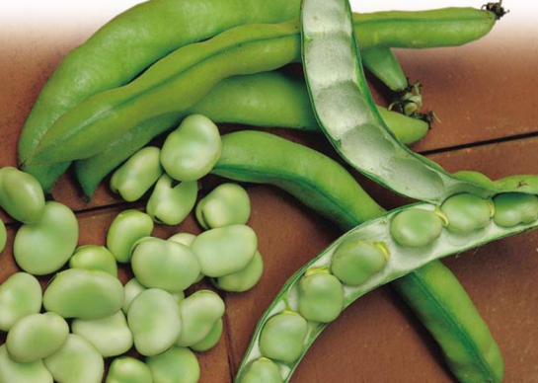
Other Experiment similar to Messelson and Stahl’s Experiment
Taylor and et. al, 1958 used of radioactive thymidine to detect distribution of newly synthesised DNA in the chromosomes was performed on Vicia faba (faba beans).

Slide 51
The Machinery and the Enzymes
Read on page no. 106-7 6.4.2 The Machinery and the Enzymes
Pre-test
When do DNA replicates in eukaryotic cells?
Answer: During the synthesis phase (S-phase) of cell cycle
Notes:
E. Coli requires a set of catalysts (enzymes) for replication
Features of the enzymes;
Highly efficient enzymes (catalyse polymerisation of a large number of nucleotides in a very short time).
Has high degree of accuracy.
Any mistake during replication would result into mutations.
Energetically replication is a very expensive process.
Deoxyribonucleoside triphosphates serve dual purposes
Act as substrates
Provide energy for polymerisation reaction (the two terminal phosphates in a deoxynucleoside triphosphates are high-energy phosphates).
E. Coli requires a set of catalysts (enzymes) for replication .
DNA-dependent DNA polymerase (uses a DNA template to catalyse the polymerisation of deoxynucleotides).
Highly efficient enzymes (catalyse polymerisation of a large number of nucleotides in a very short time, with high degree of accuracy ).
E. coli that has only 4.6 ×10⁶ bp (compare it with human whose diploid content is 6.6 × 10⁹ bp), completes the process of replication within 38 minutes; that means the average rate of polymerisation has to be approximately 2000 bp per second.
Any mistake during replication would result into mutations.
Energetically replication is a very expensive process.
Deoxyribonucleoside triphosphates serve dual purposes
acting as substrates,
provide energy for polymerisation reaction (the two terminal phosphates in a deoxynucleoside triphosphates are high-energy phosphates, same as in case of ATP).

Slide 52
Two steps of gene expression (Central Dogma of molecular biology)
3'
5'
DNA Helix
(Polymer of deoxyribonucleotide)
5'
3'
1. Transcription
mRNA
(Polymer of ribonucleotide)
2. Translation
Protein
(Polymer of amino acids)

Slide 53
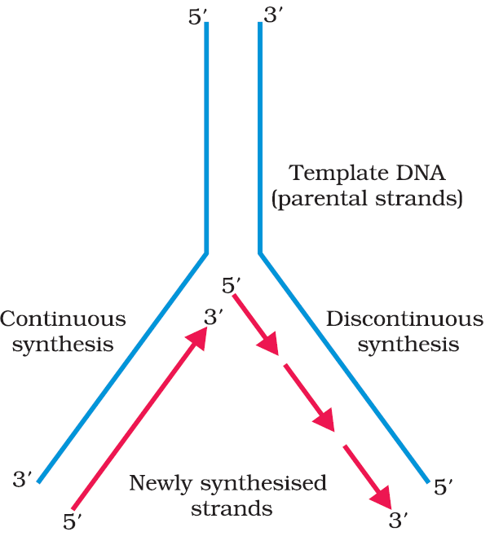
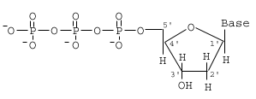
Terminologies*
Term | Description
Replication fork
Helicases
Deoxyribonucleaoside triphosphate
DNA polymerase
Primase
Primer
DNA ligase
Lagging strand
Origin of replication
A small opening of the DNA helix
Enzyme that helps in unwinding of double stranded DNA
Act as substrate and provide energy for polymerisation of nucleotides
Catalyse the polymerisation of deoxynucleotides in 5'→3‘ using DNA template
Enzyme that synthesizes primers (short RNA sequences )
Short RNA sequence that serve as a starting point for DNA synthesis
Joins lagging strand (discontinuously synthesised fragment)
Discontinuously synthesised fragments
Region in DNA where the replication originates
Figure: Replicating Fork
Figure: Deoxyribonucleaoside triphosphate

Slide 54
Replication of DNA
5‘
3‘
Formation of replication fork
The DNA-dependent DNA polymerases catalyse polymerisation of DNA in 5'→3‘ direction on the DNA template with polarity 3'→5'
5‘
3‘
Form leading strand (continuous strand)
3‘
5‘
5‘
3‘
Synthesis of lagging strand (discontinuous strand/Okazaki fragments) on the DNA template with polarity 5'→3'
Figure: Replicating Fork
DNA ligase joins lagging strand
Watch an animation on Replication of DNA: https://youtu.be/TNKWgcFPHqw
Notes:
For long DNA molecules, since the two strands of DNA cannot be separated in its entire length (due to very high energy requirement), the replication occur within a small opening of the DNA helix, referred to as replication fork. The DNA-dependent DNA polymerases catalyse polymerisation only in one direction, that is 5' → 3' .
This creates some additional complications at the replicating fork.
Consequently, on one strand (the template with polarity 3' → 5' ), the replication is continuous, while on the other (the template with polarity 5' → 3' ), it is discontinuous. The discontinuously synthesised fragments are later joined by the enzyme DNA ligase.
The DNA polymerases on their own cannot initiate the process of replication. Also the replication does not initiate randomly at any place in DNA. There is a definite region in E. coli DNA where the replication originates. Such regions are termed as origin of replication. It is

Slide 55
Transcription ( according to Central Dogma of molecular biology)
3'
5'
DNA Helix
(Polymer of deoxyribonucleotide)
5'
3'
1. Transcription
(Copying genetic information from one strand of the DNA into RNA)
mRNA
(Polymer of ribonucleotide)
2. Translation
Protein
(Polymer of amino acids)

Slide 56
Transcription
Transcription is the process of copying genetic information (genetic codes) from one strand of the DNA into RNA.
A segment of one strand of DNA (template) is transcribed into RNA
Why both the strands are not copied during transcription?
Answer:
Incase both strands act a template, they would code for RNA molecule with different sequences, and in turn, if they code for different proteins, with different sequence of amino acids. Hence, one segment of the DNA would be coding for two different proteins, and this would complicate the genetic information transfer machinery.
Moreover, the two RNA molecules if produced simultaneously would be complementary to each other, hence would form a double stranded RNA. This would prevent RNA from being translated into protein and the exercise of transcription would become a futile one.

Slide 57
Why both the strands are not copied during transcription?
Protein A
Translation
U C G A U C G A U C G A C G A U C G U C G A C G A. mRNA
3'
5'
A G C T A G C T A G C T G C T A G C A G C T G C T
DNA Helix
T C G A T C G A T C G A C G A T C G T C G A C G A
5'
3'
A G C U A G C U A G C U G C U A G C A G C U G C U mRNA
Translation
Protein B

Slide 58
Transcription Unit
A transcription unit in DNA comprises of three regions:
A Promoter
The Structural gene
A Terminator
Two strands of the DNA in the structural gene of a transcription unit are;
Template strand (with polarity 3'→5‘)
Coding strand (with polarity 5'→3‘)

Slide 59
Transcription Unit
Three regions of transcription unit | Location
Promoter (TATA Box)
Terminator
Structural gene (Cistron)
Towards 5'-end (upstream) of the coding strand of structural gene
Towards 3'-end (downstream) of the coding strand
Promoter and terminator flank the structural gene
Location of promoter, structural gene and terminator are described on the basis of coding strand
Promoter
Terminator
3'
<-------- Structural gene --------->
5'
Template strand
5'
3'
Coding strand
Figure: Schematic structure of a transcription unit

Slide 60
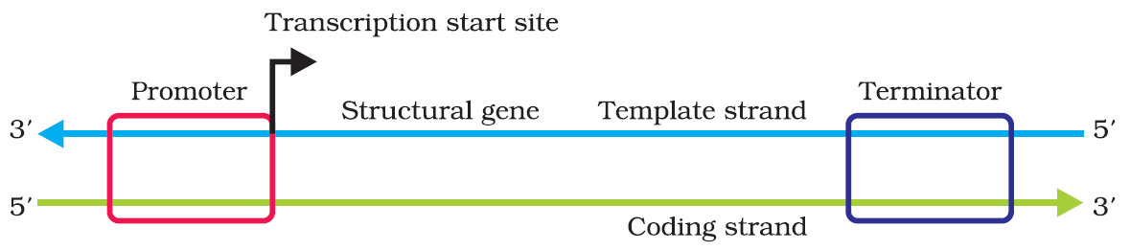
Figure: Schematic structure of a transcription unit
U C G A U C G A U C G A C G A U C G U C G A C G A. mRNA
3'
5'
Template strand
A G C T A G C T A G C T G C T A G C A G C T G C T
T C G A T C G A T C G A C G A T C G T C G A C G A
5'
3'
Coding strand
Figure DNA Helix (Transcription unit)

Slide 61
U C G A U C G A U C G A C G A U C G U C G A C G A. mRNA
A G C T A G C T A G C T G C T A G C A G C T G C T
Template strand
T C G A T C G A T C G A C G A T C G T C G A C G A
5'
3'
Coding strand
Figure DNA Helix (Transcription unit)

Slide 62
Cistron (Structural gene )
Cistron is a segment of DNA (or RNA) coding for a specific polypeptide.
Cistron
(Structural gene)
Monocistron
(mostly in eukaryotes)
Polycistron
(mostly in prokaryotes)

Slide 63
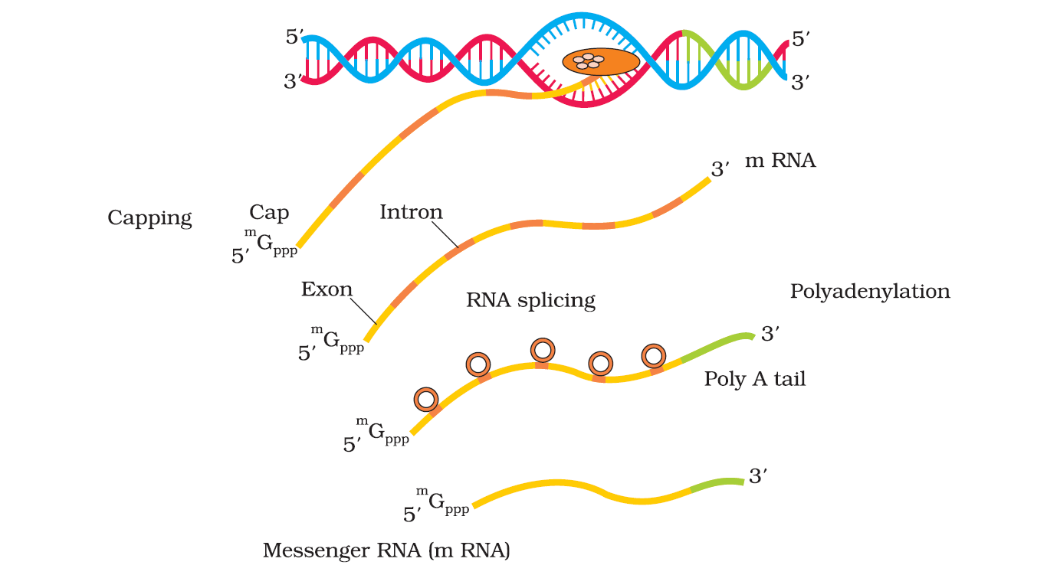
Eukaryotic cistron
Eukaryotic monocistronic structural genes have interrupted coding sequences i.e Exons are interrupted by introns.
Exons/coding sequences are expressed sequences
Exons appear in mature or processed RNA
Introns: intervening sequences
Introns do not appear in mature or processed RNA.
Regulatory genes : sequence of DNA that usually do not code for any protein.
hnRNA
(Tailing)
Figure Processing of Transcribed RNA in Eukaryotes

Slide 64
Table Types of RNA and their functions
Three major types of RNA | Function (All these RNAs are needed to synthesise protein in a cell)
Messenger RNA (mRNA)
Provides the template for translation
Transfer RNA (tRNA)
Brings amino acids and reads the genetic code during translation
Ribosomal RNA (rRNA)
Play structural and catalytic role during translation

Slide 65
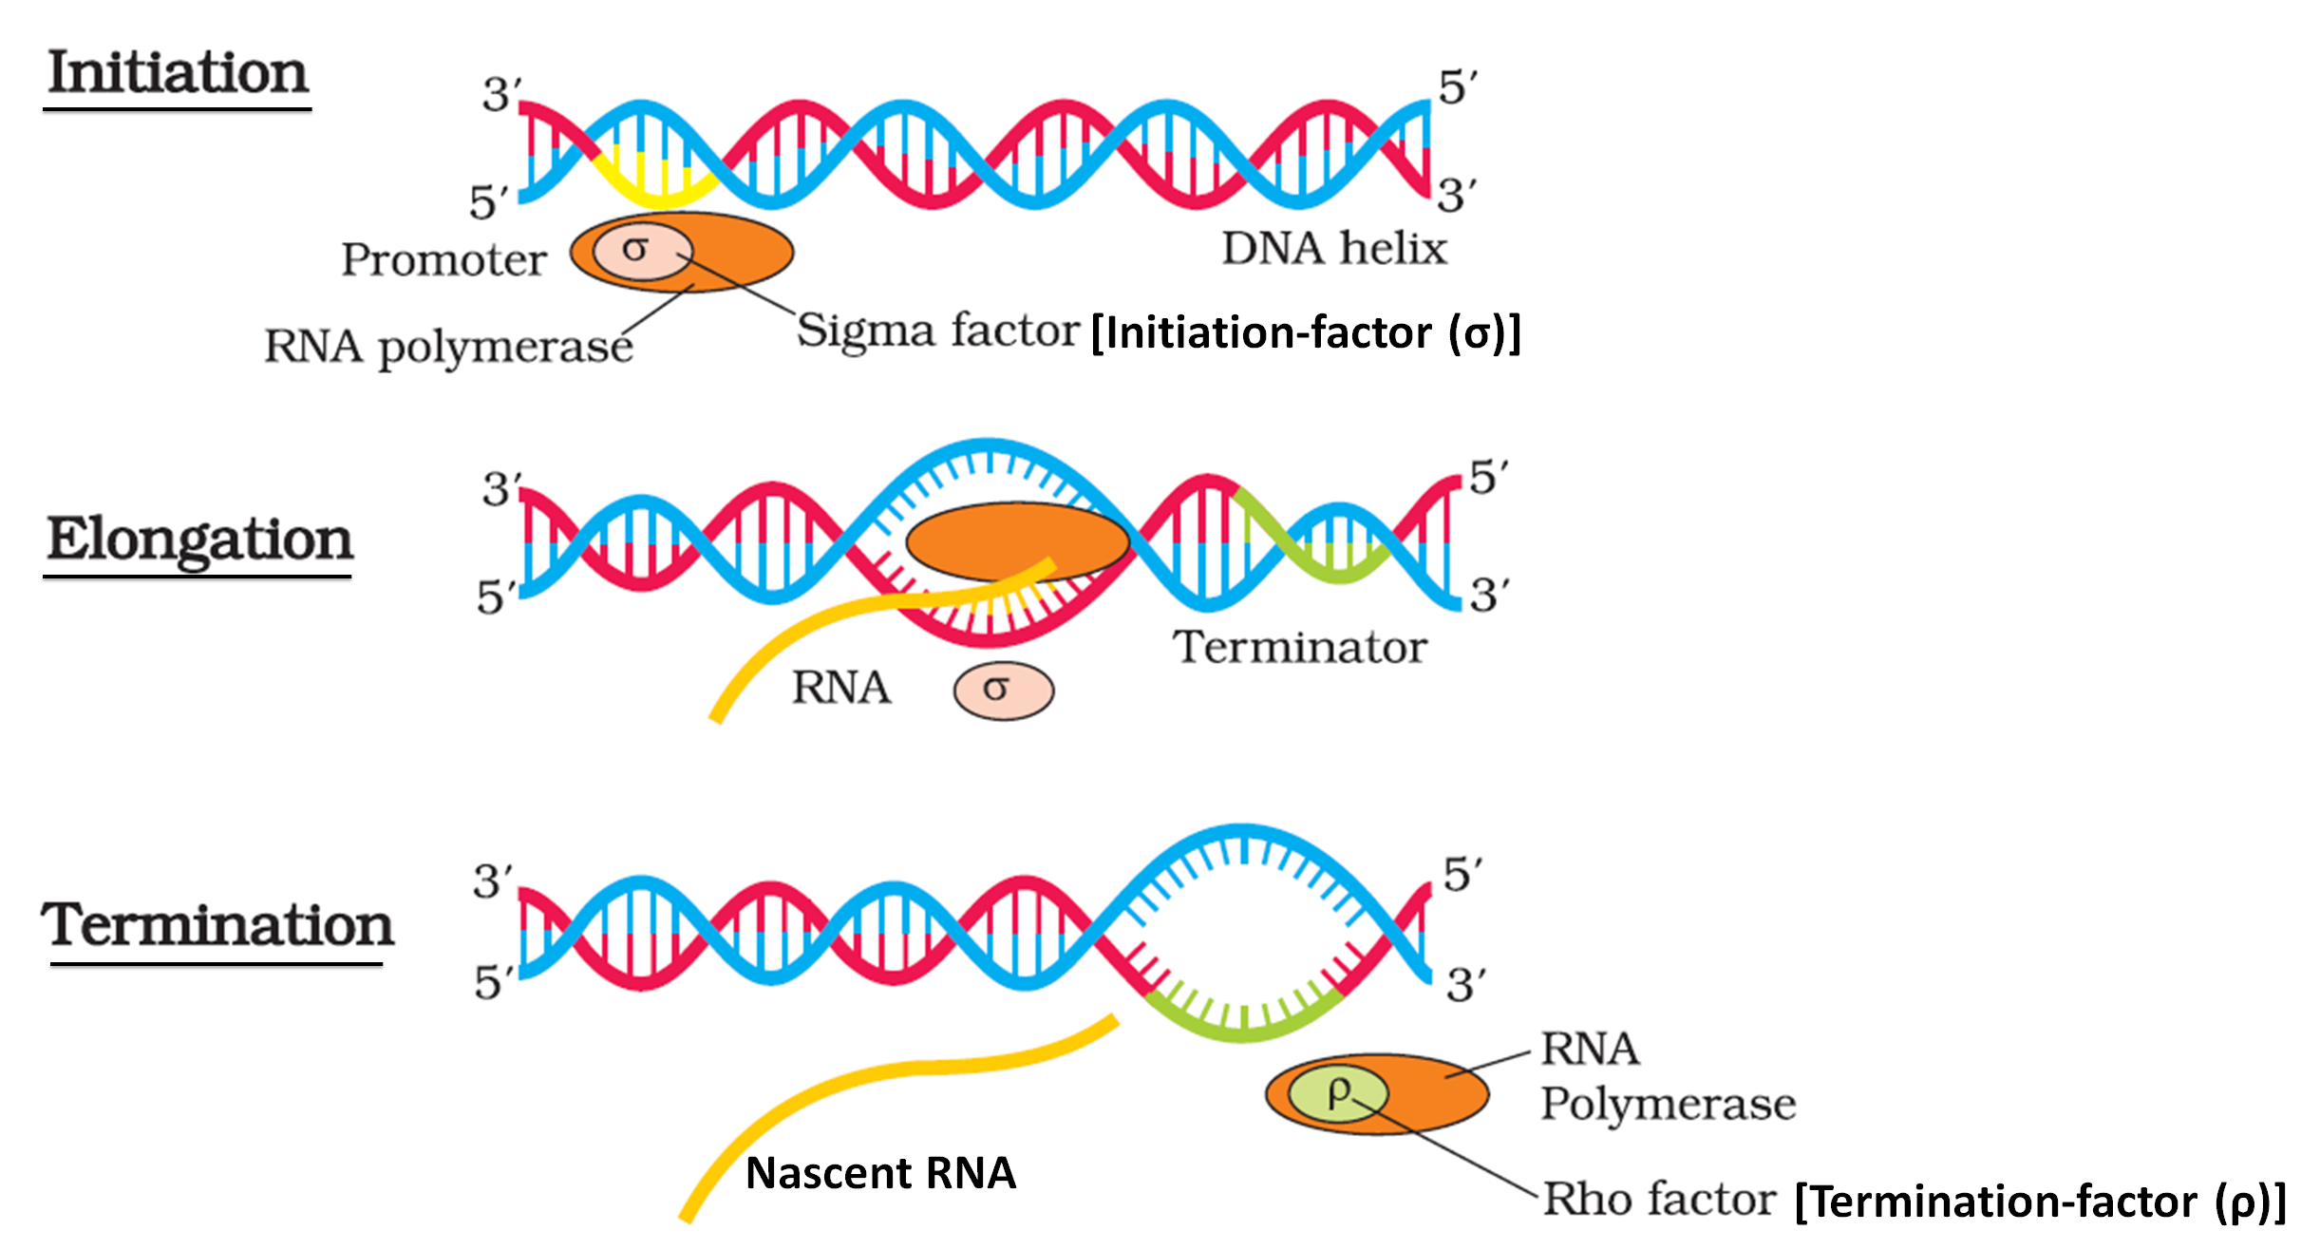
Process of Transcription in Bacteria
Uses nucleoside triphosphates as substrate
Notes:
There is single DNA-dependent RNA polymerase that catalyses transcription of all types of RNA in bacteria.
RNA polymerase associates transiently with initiation-factor (σ) binds to promoter and initiates transcription (Initiation).
RNA polymerase uses nucleoside triphosphates as substrate and polymerises in a template depended fashion following the rule of complementarity. It somehow also facilitates opening of the helix and continues elongation.
Only a short stretch of RNA remains bound to the enzyme.
RNA polymerase associates with termination-factor (ρ) terminate the transcription. Once the polymerases reaches the terminator region, the nascent RNA falls off, so also the RNA polymerase. This results in termination of transcription.
The RNA polymerase is only capable of catalysing the process of elongation. Association with these factors alter the specificity of the RNA polymerase to either initiate or terminate

Slide 66
Figure Bacterium (plural; bacteria) –Prokaryotic cell
In bacteria,
Involes only one RNA polymerase for transcription i.e formation of rRNA, tRNA, and mRNA.
mRNA does not require any processing to become active.
transcription and translation take place in the same compartment i.e bacterial cell.
The transcription and translation can be coupled in bacteria i.e many times the translation can begin much before the mRNA is full transcribed.

Slide 67
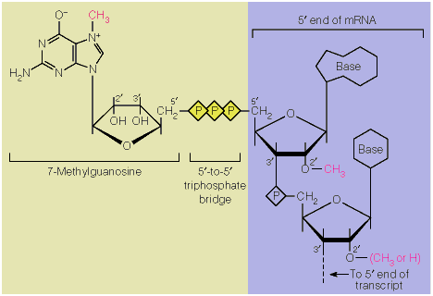
Processing of Transcribed RNA in Eukaryotes
hnRNA undergo processing called as
Splicing (process where the introns are removed and exons are joined in a defined order)
Capping (Methyl guanosine triphosphate is added to the 5'-end of hnRNA)
Tailing/polyadenylation [adenylate residues (200-300) are added at 3'-end in a template independent manner]
The fully processed heterogeneous nuclear RNA (hnRNA) , now called mRNA, that is transported out of the nucleus for translation
Figure Processing of Transcribed RNA in Eukaryotes
Methyl guanosine triphosphate
Notes:
Precursor mRNA (pre-mRNA) is an immature single strand of messenger ribonucleic acid (mRNA). Pre-mRNA is synthesized from a DNA template in the cell nucleus by transcription. Pre-mRNA comprises the bulk of heterogeneous nuclear RNA (hnRNA). The term hnRNA is often used as a synonym for pre-mRNA, although, in the strict sense, hnRNA may include nuclear RNA transcripts that do not end up as cytoplasmic mRNA.
Once pre-mRNA has been completely processed, it is termed "mature messenger RNA", "mature mRNA", or simply "mRNA".
An interrupted gene (also called a split gene) is a gene that contains sections of DNA called exons, which are expressed as RNA and protein, interrupted by sections of DNA called introns, which are not expressed. The DNA sequence in the exon provides instructions for coding proteins.
The second complexity is that the primary transcripts contain both the exons and the introns and are non-functional. Hence, it is subjected to a process called splicing where the introns are removed and exons are joined in a defined order.
hnRNA undergo two additional processing called as
capping (methyl guanosine triphosphate) is added to the 5'-end of hnRNA)
Tailing (adenylate residues (200-300) are added at 3'-end in a template independent manner)
The fully processed hnRNA, now called mRNA, that is transported out of the nucleus for translation

Slide 68

Transcription in eukaryotes
The three RNA polymerases found in the nucleus;
RNA polymerases | Function/Division of labour
RNA polymerase I
RNA polymerase II
RNA polymerase III
Transcribes rRNAs (28S, 18S, and 5.8S)
Transcribes the heterogeneous nuclear RNA (hnRNA) [Precursor of mRNA]
Transcription of tRNA, 5srRNA, and snRNAs (small nuclear RNAs)
Figure: Translation
Notes:
There are at least three RNA polymerases in the nucleus (in addition to the RNA polymerase found in the organelles). There is a clear cut division of labour.
The RNA polymerase I transcribes rRNAs (28S, 18S, and 5.8S),
The RNA polymerase II transcribes precursor of mRNA, the heterogeneous nuclear RNA (hnRNA).
RNA polymerase III is responsible for transcription of tRNA, 5srRNA, and snRNAs (small nuclear RNAs).

Slide 69




Genetic Code
(Sequence of nucleotide in DNA or RNA that determine the amino acid sequence of protein)
George Gamow
Har Gobind Khorana
Severo Ochoa
Marshall Nirenberg
Scientists | Contribution
George Gamow
-a physicist
Suggested that in order to code for all the 20 amino acids, the code should be made up of three nucleotides by proposing ‘Triplet Hypothesis’ -codons are triplet. [4³ =64 codons]
Developed a chemical method for synthesising RNA molecules with defined combinations of bases (homopolymers and copolymers)
Har Gobind Khorana
Severo Ochoa enzyme (polynucleotide phosphorylase) was also helpful in polymerising RNA with defined sequences in a template independent manner (enzymatic synthesis of RNA).
Severo Ochoa
Marshall Nirenberg
Cell-free system for protein synthesis
These contribution helped the code to be deciphered* and a checker-board for genetic code was prepared
*Decoded
Notes:
The genetic code is the set of rules by which information encoded in genetic material (DNA or RNA sequences) is translated into proteins (amino acid sequences) by living cells.
Specifically, the code defines a mapping between tri-nucleotide sequences called codons and amino acids; every triplet of nucleotides in a nucleic acid sequence specifies a single amino acid.
George Gamow, a physicist, argued that since there are only 4 bases and if they have to code for 20 amino acids, the code should constitute a combination of bases. He suggested that in order to code for all the 20 amino acids, the code should be made up of three nucleotides. This was a very bold proposition, because a permutation combination of 43 (4 × 4 × 4) would generate 64 codons; generating many more codons than required
George Gamow, a physicist, suggested that in order to code for all the 20 amino acids, the code should be made up of three nucleotides.
codon was a triplet
Har Gobind Khorana developed a chemical method for synthesising RNA molecules with defined combinations of bases (homopolymers and copolymers).
Marshall Nirenberg’s cell-free system for protein synthesis finally helped the code to be deciphered.
Severo Ochoa enzyme (polynucleotide phosphorylase) was also helpful in polymerising RNA with defined sequences in a template independent manner (enzymatic synthesis of RNA).
Finally a checker-board for genetic code was prepared

Slide 70

The Checkerboard: Codons for the 20 Amino Acids
Three Stop Codons:
UAA, UAG, UGA
Start/Initiator Codons:
AUG
/Start or initiator codon

Slide 71
Salient features of genetic code ^{NCERT textbook page number 112}
The codon is triplet. 61 codons code for amino acids and 3 codons (UAA, UAG & UGA) do not code for any amino acids, hence they function as stop codons.
Triplet codon codes for only one amino acid, hence, it is unambiguous and specific.
Some amino acids are coded by more than one codon, hence the code is degenerate.
The codon is read in mRNA in a contiguous fashion. There are no punctuations.
The code is universal. For example, from bacteria to human UUU would code for Phenylalanine (phe). Some exceptions to this rule have been found in mitochondrial codons, and in some protozoans.
AUG has dual functions i.e. AUG codes for Methionine (met), and act as initiator codon.
The Checkerboard: Codons for the 20 Amino Acids
Notes:
Degenerate: being or having multiple states, types, etc. with the same or similar property

Slide 72
Mutation
Mutation is a phenomenon which results in alteration of DNA sequences and consequently results in changes in the genotype and phenotype of an organism.
Gene/Point mutation is due to change in a single base pair of DNA. Example Sickle cell anemia (GAG→GUG i.e Glutamic acid → Valine).
Some types of Mutation
Substitution
Insertion
Deletion
Frameshift
C T G G A G
C T G G . A G
C T G G A G
THE FAT CAT SAT
C T G G G G
C T G G T G G A G
C T A G
HEF ATC ATS AT

Slide 73
Illustration of Frame shift mutation
Insertion of letters B, I and G and rearranging the statement to make a triplet word
Deleting the letters R, E and D, one by one and rearranging the statement to make a triplet word
B
RAM HAS RED CAP
RAM HAS RED CAP
R
RAM HAS EDC AP
I
E
RAM HAS BRE DCA P
RAM HAS DCA P
G
D
RAM HAS BIR EDC AP
RAM HAS CAP
RAM HAS BIG RED CAP
Notes:
Insertion or deletion of one or two bases changes the reading frame from the point of insertion or deletion.
Insertion or deletion of three or its multiple bases insert or delete one or multiple codon hence one or multiple amino acids, and reading frame remains unaltered from that point onwards. Such mutations are referred to as frame-shift insertion or deletion mutations.
This forms the genetic basis of proof that codon is a triplet and it is read in a contiguous manner.

Slide 74
Two steps of gene expression (Central Dogma of molecular biology)
3'
5'
A G C T A G C T A G C T G C T A G C A G C T G C T
DNA Helix
(Polymer of deoxyribonucleotide)
T C G A T C G A T C G A C G A T C G T C G A C G A
5'
3'
1. Transcription
mRNA
(Polymer of ribonucleotide)
U C G A U C G A U C G A C G A U C G U C G A C G A
2. Translation
Protein
(Polymer of amino acids)

Slide 75


Transfer RNA (tRNA) –the Adapter Molecule
Earlier known as sRNA (soluble RNA)
Francis Crick postulated the presence of an adapter molecule that would on one hand read the code and on other hand would bind to specific amino acids.
Role as an adapter molecule was assigned much later.
Amino acid
Amino acid accepter end
T loop
(helps in binding to ribosome)
D loop
(helps in binding to amino acyl synthetase)
Variable loop
(Variable in nucleotide composition and length)
Anticodon loop
Notes:
After the proposition of code, it was clear to Francis Crick that there has to be a mechanism to read the code and also to link it to the amino acids, because amino acids have no structural specialities to read the code uniquely.
He postulated the presence of an adapter molecule that would on one hand read the code and on other hand would bind to specific amino acids.
The tRNA, then called sRNA (soluble RNA), was known before the genetic code was postulated. However, its role as an adapter molecule was assigned much later.

Slide 76


Clover leaf like Secondary structure of tRNA
Notes:
Secondary structure of tRNA has been depicted that looks like a clover-leaf. In actual structure, the tRNA is a
compact molecule which looks like inverted L.

Slide 77

tRNA is a compact, inverted L shaped molecule in actual structure

Slide 78
Translation
Translation refers to the process of polymerisation of amino acids to form a polypeptide.
The sequence of bases (Genetic codes/triplet Codons) in the mRNA defines the order and sequence of amino acids (joined by peptide bonds).
Formation of a peptide bond requires energy.
3'
5'
A G C T A G C T A G C T G C T A G C A G C T G C T
DNA Helix
(Polymer of deoxyribonucleotide)
T C G A T C G A T C G A C G A T C G T C G A C G A
5'
3'
1. Transcription
mRNA
(Polymer of ribonucleotide)
U C G A U C G A U C G A C G A U C G U C G A C G A
2. Translation
Protein
(Polymer of amino acids)
Notes:
Translation refers to the process of polymerisation of amino acids to form a polypeptide.
The order and sequence of amino acids are defined by the sequence of bases in the mRNA.
The amino acids are joined by a bond which is known as a peptide bond.
Formation of a peptide bond requires energy.
Therefore, in the first phase itself amino acids are activated in the presence of ATP and linked to their cognate tRNA– a process commonly called as charging of tRNA or aminoacylation of tRNA to be more specific. If two such charged tRNAs are brought close enough, the formation of peptide bond between them would be favoured energetically. The presence of a catalyst would enhance the rate of peptide bond formation.
aminoacyl tRNAsynthetase (aaRS) is an enzyme that attaches the appropriate amino acid onto its tRNA. It does so by catalyzing the esterification of a specific cognate amino acid or its precursor to one of all its compatible cognate tRNAs to form an aminoacyl-tRNA.

Slide 79
Aminoacylation of tRNA
(Charging of tRNA or formation of aminoacyl tRNA)
In aminoacylation of tRNA, amino acids are activated in the presence of ATP using amino acyl synthetase and linked to their cognate tRNA to form aminoacyl tRNA.
If two such charged tRNAs are brought close enough, the formation of peptide bond between them would be favoured energetically.
The presence of a catalyst would enhance the rate of peptide bond formation.
Notes:
Translation refers to the process of polymerisation of amino acids to form a polypeptide.
The order and sequence of amino acids are defined by the sequence of bases in the mRNA.
The amino acids are joined by a bond which is known as a peptide bond.
Formation of a peptide bond requires energy.
Therefore, in the first phase itself amino acids are activated in the presence of ATP and linked to their cognate tRNA– a process commonly called as charging of tRNA or aminoacylation of tRNA to be more specific. If two such charged tRNAs are brought close enough, the formation of peptide bond between them would be favoured energetically. The presence of a catalyst would enhance the rate of peptide bond formation.
aminoacyl tRNAsynthetase (aaRS) is an enzyme that attaches the appropriate amino acid onto its tRNA. It does so by catalyzing the esterification of a specific cognate amino acid or its precursor to one of all its compatible cognate tRNAs to form an aminoacyl-tRNA.

Slide 80


Ribosome
Ribosome is the cellular factory responsible for synthesising proteins
The ribosome consists of
structural RNAs and
80 different proteins.
In inactive state, ribosome exists as two subunits;
a large subunit (has three sites –E, P & A sites) and
a small subunit (binds to mRNA).
Figure Schematic diagram of Ribosome
Notes:
When the small subunit encounters an mRNA, the process of translation of the mRNA to protein begins.
There are two sites in the large subunit, for subsequent amino acids to bind to and thus, be close enough to each other for the formation of a peptide bond.
The ribosome also acts as a catalyst (23S rRNA in bacteria is the enzyme- ribozyme) for the formation of peptide bond.

Slide 81

Translational unit
A translational unit is present in mRNA coding for a polypeptide
It is the sequence of RNA that is flanked by the start codon (AUG) and the stop codon.
Untranslated, additional sequences of mRNA that are present at both 5' -end (before start codon) and at 3' -end (after stop codon) are referred as untranslated regions (UTR).
UTRs are required for efficient translation process.

Slide 82
Three steps of translation
Initiation
Elongation
Termination
Notes:
Initiation
For initiation, the ribosome binds to the mRNA at the start codon (AUG) that is recognised only by the initiator tRNA.
Then a transfer RNA (tRNA) molecule carrying the amino acid methionine binds to start codon of the mRNAsequence. The start codon in all mRNA molecules has the sequenceAUG and codes for methionine. Next, the large ribosomal subunitbinds to form the complete initiation complex.
Elongation
The ribosome proceeds to the elongation phase of protein synthesis. During this stage, complexes composed of an amino acid linked to tRNA, sequentially bind to the appropriate codon in mRNA by forming complementary base pairs with the tRNA anticodon. The ribosome moves from codon to codon along the mRNA. Amino acids are added one by one, translated into Polypeptide sequences dictated by DNA and represented by mRNA. At the end, a release factor binds to the stop codon, terminating translation and releasing the complete polypeptide from the ribosome.
Termination
When a ribosome reaches the codon UAG, UAA, or UGA on an mRNA strand then protein synthesis is terminated. A protein known as arelease factor binds to the ribosome and adds a water molecule to the end of the amino acid chain.

Slide 83

Translation

Slide 84
Figure: Translation

Slide 85

Animation: Translation

Slide 86
Translation
Ribosome binds to the mRNA at the start codon (AUG)
Recognised by the initiator tRNA
Aminoacylated tRNA sequentially bind to the appropriate codon in mRNA by forming complementary base pairs with the tRNA anticodon while ribosome translocate (moves) from codon to codon along the mRNA
The Amino acids are added one by one, translated into Polypeptide sequences dictated by DNA and represented by mRNA.
At the end, a release factor binds to the stop codon (UAG, UAA, or UGA), terminating translation and releasing the complete polypeptide from the ribosome.
Notes:
Initiation
For initiation, the ribosome binds to the mRNA at the start codon (AUG) that is recognised only by the initiator tRNA.
Then a transfer RNA (tRNA) molecule carrying the amino acid methionine binds to start codon of the mRNAsequence. The start codon in all mRNA molecules has the sequenceAUG and codes for methionine. Next, the large ribosomal subunitbinds to form the complete initiation complex.
Elongation
The ribosome proceeds to the elongation phase of protein synthesis. During this stage, complexes composed of an amino acid linked to tRNA, sequentially bind to the appropriate codon in mRNA by forming complementary base pairs with the tRNA anticodon. The ribosome moves from codon to codon along the mRNA. Amino acids are added one by one, translated into Polypeptide sequences dictated by DNA and represented by mRNA. At the end, a release factor binds to the stop codon, terminating translation and releasing the complete polypeptide from the ribosome.
Termination
When a ribosome reaches the codon UAG, UAA, or UGA on an mRNA strand then protein synthesis is terminated. A protein known as arelease factor binds to the ribosome and adds a water molecule to the end of the amino acid chain.

Slide 87

Translation

Slide 88
REGULATION OF GENE EXPRESSION

Slide 89
Gene Expression
Gene expression results in the formation of a polypeptide (protein).
DNA
DNA
X
mRNA
Gene Expression
Gene Is Not Expressed
Protein
No protein

Slide 90
Regulation Of Gene Expression
Gene expression is regulated at various levels.
In eukaryotes, the regulation of gene expression could be exerted at
transcriptional level (formation of primary transcript)
processing level (regulation of splicing),
transport of mRNA from nucleus to the cytoplasm,
translational level.
Expression of genes is regulated by;
metabolic conditions,
physiological conditions or
environmental conditions
Genes in a cell are expressed to perform a particular function or set of functions.

Slide 91
Regulation Of Gene Expression In Prokaryotes
In prokaryotes, transcriptional initiation is the predominant site (i.e. promoter) for control of gene expression.
In a transcriptional unit, the activity of RNA polymerase at a given promoter is regulated by interaction with Regulatory proteins, which affect its ability to recognise start sites.
Regulatory proteins can act both
positively (activators) and
negatively (repressors).
Notes:
For example, if an enzyme called beta-galactosidase is synthesised by E. coli, it is used to catalyse the hydrolysis of a disaccharide, lactose into galactose and glucose; the bacteria use them as a source of energy. Hence, if the bacteria do not have lactose around them to be utilised for energy source, they would no longer require the synthesis of the enzyme beta-galactosidase. Therefore, in simple terms, it is the metabolic, physiological or environmental conditions that regulate the expression of genes. The development and differentiation of embryo into adult organisms are also a result of the coordinated regulation of expression of several sets of genes.

Slide 92


Important terms
Operon: sequence of DNA containing a cluster of genes under the control of a single promoter.
Examples of bacterial operon are: lac operon, trp operon, ara operon, his operon, val operon, etc.
lac operon (lac refers to lactose) is a polycistronic structural gene is regulated by a common promoter and regulatory genes.
Inducer: Bio-molecule that favours gene expression
Repressor: Bio-molecule that doesn’t allow gene expression
Notes:
Elucidated: clarified

Slide 93
The Lac operon: elucidated by Francois Jacob (geneticist) and Jacque Monod (biochemist)
In the absence of inducer (Lactose/Allolactose)
Regulatory gene I
(I refers to inhibitor)
3 structural genes
P
i
P
O
z
y
a
r

Slide 94
The Lac operon: elucidated by Francois Jacob (geneticist) and Jacque Monod (biochemist)
In the presence of inducer (Lactose/Allolactose)
Regulatory gene I
(I refers to inhibitor)
3 structural genes
P
i
P
O
z
y
a
σ
Regulates switching on and off of the operon
Repressor
Lactose
β-gal (β-galactosidase)
Permease
Transacetylase
hydrolysis of lactose into galactose and glucose.
Increases permeability of the cell to lactose/ β-galactosides
Function not yet known
Regulation of lac operon by repressor is referred to as negative regulation

Slide 95

The Lac operon: elucidated by Francois Jacob (geneticist) and Jacque Monod (biochemist)
Regulation of lac operon by repressor is referred to as negative regulation
Regulatory gene I
(I refers to inhibitor)
3 structural genes
(Lactose)
(β-gal)
Function not yet known
Lactose
hydrolysis of lactose into galactose and glucose.
Increases permeability of the cell to β-galactosides (lactose)

Slide 96
Regulation Of Gene Expression In Prokaryotes
The accessibility of promoter regions of prokaryotic DNA for RNA polymerase is regulated by the interaction of proteins with operators.
The operator region is adjacent to the promoter elements in most operons
In most cases the sequences of the operator bind a repressor protein.
Each operon has its specific operator and specific repressor.
For example, lac operator is present only in the lac operon and it interacts specifically with lac repressor only.
Notes:
For example, if an enzyme called beta-galactosidase is synthesised by E. coli, it is used to catalyse the hydrolysis of a disaccharide, lactose into galactose and glucose; the bacteria use them as a source of energy. Hence, if the bacteria do not have lactose around them to be utilised for energy source, they would no longer require the synthesis of the enzyme beta-galactosidase. Therefore, in simple terms, it is the metabolic, physiological or environmental conditions that regulate the expression of genes. The development and differentiation of embryo into adult organisms are also a result of the coordinated regulation of expression of several sets of genes.

Slide 97
The Lac operon
The lac operon consists of one regulatory gene (I gene –term I refer to inhibitor) and three structural genes (z, y, and a).
The I gene codes for the repressor of the lac operon.
z gene codes for beta-galactosidase (β-gal), which is primarily responsible for the hydrolysis of the disaccharide, lactose into its monomeric units, galactose and glucose.
The y gene codes for permease, which increases permeability of the cell to β-galactosides (lactose).
The a gene encodes a transacetylase.
All the three gene products in lac operon Beta-galactosidase, permease, transacetylase are required for metabolism of lactose.
Lactose is the substrate for the enzyme beta-galactosidase
Lactose regulates switching on and off of the operon. Hence, it is termed as inducer.
In the absence of a preferred carbon source such as glucose, if lactose is provided in the growth medium of the bacteria, the lactose is transported into the cells through the action of permease (Remember, a very low level of expression of lac operon has to be present in the cell all the time, otherwise lactose cannot enter the cells).
The lactose then induces the operon in the following manner.
The repressor of the operon is synthesised (all-the-time – constitutively) from the i gene.
The repressor protein binds to the operator region of the operon and prevents RNA polymerase from transcribing the operon.
In the presence of an inducer, such as lactose or allolactose, the repressor is inactivated by interaction with the inducer. This allows RNA polymerase access to the promoter and transcription proceeds. Essentially, regulation of lac operon can also be visualised as regulation of enzyme synthesis by its substrate. Remember, glucose or galactose cannot act as inducers for lac operon.
Regulation of lac operon by repressor is referred to as negative regulation.
Notes:
Elucidated: clarified

Slide 98
Pre-test: Human Genome Project
What was aim the of human genome project?
Genetic make-up of an organism lies in the DNA sequences _________(True/False).
If two individuals differ, then their DNA sequences should also be ________, at least at some places.
What are the reasons for possibility of launching HGP in the year 1990?
Why Human Genome Project (HGP) was called a mega project?
Enlist some non-human organisms whose DNA sequence have also been sequenced?
Notes:
Sequence of bases in DNA that determines the genetic information of a given organism.

Slide 99
Questions and answers on Human genome project (HGP)
Question: When did the human genome project was started and finished?
Answer: Started in October 1990 and completed in April 2003.
Question: What were the departments which coordinated the HGP?
Answer: Coordinated by the U.S. Department of Energy and the National Institute of Health under the initial leadership of James Watson.
Question: Which Trust became major partner during the early years of the HGP?
Answers: The Wellcome Trust (U.K.) became a major partner
Question: Name some of the contributing countries.
Answer: Japan, France, Germany, China and others
Question: What is the aim/goals of human genome project?
Answer: Human genome project (HGP) was aimed to find complete DNA sequence of human genome i.e complete mapping and understanding of all the genes of human beings.
Question: Why is the human genome project important?
Answer: Knowledge about the effects of DNA variations among individuals can lead to revolutionary new ways to diagnose, treat and prevent thousands of disorders that affect human beings.
Question: State the assumptions leading to the quest for human genome project to find complete DNA sequence of human genome.
Answer: Assumptions leading to the quest for human genome project are;
Genetic make-up of an organism lies in the DNA sequences.
If two individuals differ, then their DNA sequences should also be different, at least at some places.
Notes:
The Human Genome Project was a 13-year (Started in 1990 and completed in 2003) project coordinated by the U.S. Department of Energy and the National Institute of Health.
During the early years of the HGP, the Wellcome Trust (U.K.) became a major partner
Additional contributions came from Japan, France, Germany, China and others.
Knowledge about the effects of DNA variations among individuals can lead to revolutionary new ways to diagnose, treat and someday prevent the thousands of disorders that affect human beings.
Besides providing clues to understanding human biology, learning about non-human organisms DNA sequences can lead to an understanding of their natural capabilities that can be applied toward solving challenges in health care, agriculture, energy production, environmental remediation.
Many non-human mode organisms, such as bacteria, yeast, Caenorhabditis elegans (a free living non-pathogenic nematode), Drosophila (the fruit fly), plants (rice and Arabidopsis), etc., have also been sequenced.

Slide 100
Just for information
DNA of bacteria, yeast, Caenorhabditis elegans (a free living non-pathogenic nematode), Drosophila (the fruit fly), plants (rice and Arabidopsis), etc., have also been sequenced.
Advantages of learning about non-human organisms DNA sequences;
providing clues to understanding human biology
can lead to an understanding of their natural capabilities that can be applied toward solving challenges in health care, agriculture, energy production, environmental remediation.
Notes:
The Human Genome Project was a 13-year (Started in 1990 and completed in 2003) project coordinated by the U.S. Department of Energy and the National Institute of Health.
During the early years of the HGP, the Wellcome Trust (U.K.) became a major partner
Additional contributions came from Japan, France, Germany, China and others.
Knowledge about the effects of DNA variations among individuals can lead to revolutionary new ways to diagnose, treat and someday prevent the thousands of disorders that affect human beings.
Besides providing clues to understanding human biology, learning about non-human organisms DNA sequences can lead to an understanding of their natural capabilities that can be applied toward solving challenges in health care, agriculture, energy production, environmental remediation.
Many non-human mode organisms, such as bacteria, yeast, Caenorhabditis elegans (a free living non-pathogenic nematode), Drosophila (the fruit fly), plants (rice and Arabidopsis), etc., have also been sequenced.

Slide 101



Mention the possibility to accomplish Human Genome Project
Availability of genetic engineering techniques
Possibility to isolate and clone any piece of DNA
Availability of simple and fast techniques for determining DNA sequences
Notes:
Sequence of bases in DNA that determines the genetic information of a given organism.

Slide 102
Why HGP is a mega project?
Human genome is said to have approximately 3 x 10⁹ bp, and its estimated cost was approximately 9 billion US dollars i.e if the cost of sequencing required is US $ 3 per bp (the estimated cost in the beginning.
HGP require the expertise and creativity of tens of thousands of scientists from varied disciplines in both the public and private sectors worldwide.
The enormous amount of data* generated necessitated the use of high speed computational devices for data storage and retrieval, and analysis.
HGP was closely associated with the rapid development of Bioinformatics (i.e a new area in biology).
*If the obtained sequences were to be stored in typed form in books, and if each page of the book contained 1000 letters and each book contained 1000 pages, then 3300 such books would be required to store the information of DNA sequence from a single human cell.

Slide 103
Protocol of HGP
Total DNA from a cell is isolated
Converted into random fragments of relatively smaller sizes
Cloned* in suitable host using specialised vectors; BAC (Bacterial Artificial Chromosomes), and YAC (Yeast Artificial Chromosomes).
Amplified DNA are sequenced using automated DNA sequencers (uses specialised computer based programs)
*Cloning resulted into amplification of each piece of DNA fragment
Automated DNA sequencers works on the principle of a method developed by Frederick Sanger. He is also credited for developing method for determination of amino acid sequences in proteins.
Notes:
For sequencing, the total DNA from a cell is isolated and converted into random fragments of relatively smaller sizes (recall DNA is a very long polymer, and there are technical limitations in sequencing very long pieces of DNA) and cloned in suitable host using specialised vectors.
The cloning resulted into amplification of each piece of DNA fragment so that it subsequently could be sequenced with ease.
The commonly used hosts were bacteria and yeast, and the vectors were called as BAC (bacterial artificial chromosomes), and YAC (yeast artificial chromosomes).

Slide 104

Methodologies of HGP
The two major approaches/methods involved in HGP are;
Expressed Sequence Tags (ESTs): focused on identifying all the genes that expressed as RNA.
Sequence Annotation: blind approach of simply sequencing the whole set of genome that contained all the coding and non-coding sequence, and later assigning different regions in the sequence with functions.

Slide 105
Sequencing DNA fragments; A step of Method in HGP
These sequences were arranged based on some overlapping regions present in them.
This generation of overlapping fragments is required for sequencing.
Alignment of these sequences was humanly not possible.
Specialised computer based programs were developed.
These sequences were subsequently annotated and were assigned to each chromosome.
The sequence of chromosome 1 was completed only in May 2006 (this was the last of the 24 human chromosomes – 22 autosomes and X and Y – to be sequenced).
Another challenging task was assigning the genetic and physical maps on the genome.
This was generated using information on polymorphism of restriction endonuclease recognition sites, and microsatellite DNA (repetitive DNA sequences).

Slide 106
Some Salient Features of Human Genome
The human genome contains 3164.7 million nucleotide bases.
The average gene consists of 3000 bases, but sizes vary greatly, with the largest known human gene being dystrophin at 2.4 million bases.
The total number of genes is estimated at 30,000 much lower than previous estimates of 80,000 to 1,40,000 genes.
Almost all (99.9 per cent) nucleotide bases are exactly the same in all people.
The functions are unknown for over 50 per cent of discovered genes.
Less than 2 per cent of the genome codes for proteins.
Repeated sequences make up very large portion of the human genome.
Repetitive sequences are stretches of DNA sequences that are repeated many times (hundred to thousand times). They are thought to have no direct coding functions, but they shed light on chromosome structure, dynamics and evolution.
Chromosome 1 has most genes (2968), and the Y has the fewest (231).
Scientists have identified about 1.4 million locations where single base DNA differences (SNPs – single nucleotide polymorphism, pronounced as ‘snips’) occur in humans. This information promises to revolutionise the processes of finding chromosomal locations for disease-associated sequences and tracing human history.

Slide 107
Applications and Future Challenges
Deriving meaningful knowledge from the DNA sequences will help in understanding of biological systems.
Complete sequence of HG sequence when properly studied, will enable radically new approach to biological research.
Can be used to study all the genes in a genome, for example,
all the transcripts in a particular tissue or organ or tumor, or
how tens of thousands of genes and proteins work together in interconnected networks to orchestrate the chemistry of life.

Slide 108
Home work
Read DNA FINGERPRINTING from page numbers 121-122

Slide 109
Why do we differ from each other?
Differences in base sequences of human genome (i.e. 3 × 10⁹ bp) make every individual unique in their phenotypic appearance.
It is technically known as Polymorphism (i.e. variation at genetic level arise due to mutation).

Slide 110

DNA fingerprinting/DNA profiling
DNA fingerprinting is a very quick way to compare the DNA sequences of any two individuals or among individuals of a population.
DNA fingerprinting was developed by Alec John Jeffreys
DNA profiling use repetitive DNA (mini-satellite DNA -VNTR) as probe.
Earlier, the technique involved Southern blot hybridisation using radio labelled Variable Number of Tandem Repeats (VNTR) as a probe.
Uses of DNA fingerprinting
Forensic applications
Used in paternity testing
Used in study of genetic biodiversity
Used in evolutionary biology
DNA fingerprinting involves identifying differences in repetitive DNA.
Notes:
Satellite DNA consists of very large arrays of tandemly repeating, non-coding DNA. Satellite DNA is the main component of functional centromeres, and form the main structural constituent of heterochromatin.
Polymorphism (genetics): the presence of genetic variation within a population, upon which natural selection can operate
a discontinuous genetic variation resulting in the occurrence of several different forms or types of individuals among the members of a single species. A discontinuous genetic variation divides the individuals of a population into two or more sharply distinct forms.
Polymorphism(Bio); the occurrence of different forms among the members of a population or colony, or in the life cycle of an individual organism

Slide 111
Genome
(DNA in Human)
Coding sequence
(Forms protein)
Non-coding sequence
Repetitive DNA
Depending on base composition (A:T rich or G:C rich), length of segment, and number of repetitive units
Introns, regulator, etc
Satellite
Mini-satellites
Micro satellites
Interpersed
(Transpsons, LTR, LINE, SINE)
Variable Number of Tandem Repeat (VNTR)
[Small DNA sequence (varies from 0.1 to 20 kb) arranged tandemly in many copy number, copy number varies from chromosome to chromosome in an individual. The numbers of repeat show very high degree of polymorphism]

Slide 112

Protocol of DNA Fingerprinting
Isolation of DNA (from sample -blood, scalf, hair, semen, hair-follicle, skin, bone, saliva, etc)
---<Polymerase Chain Reaction (PCR) is also conducted to amplify/clone the isolated DNA>---
Digestion of DNA by restriction endonucleases
Separation of DNA fragments by electrophoresis
Transferring (blotting) of separated DNA fragments to synthetic membranes, such as nitrocellulose or nylon (i.e. Southern blotting)
Hybridisation using radio labelled VNTR* probe
Detection of hybridised DNA fragments (usually appears dark bands) by autoradiography
*Variable Number of Tandem Repeats (VNTR) -a mini-satellite DNA

Slide 113


Slide 114
Chapter Ends with two Question???
What is STR?
Why STR is used in DNA fingerprinting these days?

Slide 115

Read paragraph 2 of DNA fingerprinting on page number 121
With an example explain repetitive DNA
The repetitive DNA form different peaks unlike bulk genomic DNA during density gradient centrifugation.
The bulk DNA forms a major peak and the other small peaks are referred to as satellite DNA.
The satellite DNA is classified into many categories, such as micro satellites, mini-satellites etc depending on base composition (A:T rich or G:C rich), length of segment, and number of repetitive units.
Satellite DNA sequence show high degree of polymorphism and form the basis of DNA fingerprinting.
Since DNA from every tissue (such as blood, hair-follicle, skin, bone, saliva, sperm etc.) from an individual, show the same degree of polymorphism, these become very useful identification tool in forensic applications.
As the polymorphisms are inheritable from parents to children, DNA fingerprinting is the basis of paternity testing, in case of disputes.

Slide 116
Write a note on DNA Polymorphism
Polymorphism is variation at genetic level arise due to mutation.
Polymorphism in DNA sequence is the basis of genetic mapping of human genome and DNA fingerprinting.
New mutations may arise in an individual either in
somatic cells or
germ cells (cells that generate gametes in sexually reproducing organisms).
If a germ cell mutation is inherited to successive generations successfully, then, it can spread to the other members of population (through sexual reproduction).
Allelic sequence variation has traditionally been described as a DNA polymorphism if more than one variant (allele) at a locus occurs in human population with a frequency greater than 0.01.
If an inheritable mutation is observed in a population at high frequency, it is referred to as DNA polymorphism.
The probability of such variation to be observed in non coding DNA sequence would be higher as mutations in these sequences may not have any immediate effect in an individual’s reproductive ability.
These mutations keep on accumulating generation after generation, and form one of the basis of variability/polymorphism.
DNA polymorphisms may be single nucleotide change, very large scale changes etc.
For evolution and speciation, such polymorphisms play very important role.

Slide 117
What is VNTR?
The VNTR belongs to a class of satellite DNA referred to as mini-satellite.
VNTR is small DNA sequence arranged tandemly in many copy numbers.
The copy number varies from chromosome to chromosome in an individual.
The numbers of repeat show very high degree of polymorphism.
Size of VNTR varies from 0.1 to 20 kb.
After hybridisation with VNTR probe, the autoradiogram gives many bands of differing sizes. These bands give a characteristic pattern for an individual DNA.
It differs from individual to individual in a population except in the case of monozygotic (identical) twins.
The sensitivity of the technique has been increased by use of polymerase chain reaction
DNA from a single cell is enough to perform DNA fingerprinting analysis.
Currently, many different probes are used to generate DNA fingerprints.
Notes:
A variable number tandem repeat (or VNTR) is a location in a genome where a short nucleotide sequence is organized as a tandem repeat. These can be found on many chromosomes, and often show variations in length between individuals.
Autoradiography: A technique using X- ray film to visualize molecules or fragments of molecules that have been radioactively labeled.
Autoradiography has many applications in the laboratory. Autoradiography can, for example, be used to analyze the length and number of DNA fragments after they are separated from one another by a method called gel electrophoresis
An autoradiograph is an image on an x-ray film or nuclear emulsion produced by the pattern of decay emissions (e.g., beta particles or gamma rays) from a distribution of a radioactive substance.

Slide 118
End of chapter……….

Slide 119


Slide 120


Slide 121


Slide 122


Slide 123


Slide 124


Slide 125

Mutation

Slide 126


Slide 127

Lac operon

Slide 128


Slide 129


Slide 130
Genetic Code
Scientists | Contribution
George Gamow
-a physicist
Suggested that in order to code for all the 20 amino acids, the code should be made up of three nucleotides i.e. codons are triplet
Developed a chemical method for synthesising RNA molecules with defined combinations of bases (homopolymers and copolymers)
Har Gobind Khorana
Marshall Nirenberg
Cell-free system for protein synthesis
Severo Ochoa enzyme (polynucleotide phosphorylase) was also helpful in polymerising RNA with defined sequences in a template independent manner (enzymatic synthesis of RNA).
Severo Ochoa
These contribution helped the code to be deciphered* and a checker-board for genetic code was prepared
*Decoded
Notes:
The genetic code is the set of rules by which information encoded in genetic material (DNA or RNA sequences) is translated into proteins (amino acid sequences) by living cells.
Specifically, the code defines a mapping between tri-nucleotide sequences called codons and amino acids; every triplet of nucleotides in a nucleic acid sequence specifies a single amino acid.
George Gamow, a physicist, argued that since there are only 4 bases and if they have to code for 20 amino acids, the code should constitute a combination of bases. He suggested that in order to code for all the 20 amino acids, the code should be made up of three nucleotides. This was a very bold proposition, because a permutation combination of 43 (4 × 4 × 4) would generate 64 codons; generating many more codons than required
George Gamow, a physicist, suggested that in order to code for all the 20 amino acids, the code should be made up of three nucleotides.
codon was a triplet
Har Gobind Khorana developed a chemical method for synthesising RNA molecules with defined combinations of bases (homopolymers and copolymers).
Marshall Nirenberg’s cell-free system for protein synthesis finally helped the code to be deciphered.
Severo Ochoa enzyme (polynucleotide phosphorylase) was also helpful in polymerising RNA with defined sequences in a template independent manner (enzymatic synthesis of RNA).
Finally a checker-board for genetic code was prepared

Slide 131

+U
-C

Slide 132

Process of Transcription in Bacteria
Initiation-factor (σ)
Nucleoside triphosphates
(substrate)
Nascent RNA
Termination-factor (ρ)
Notes:
There is single DNA-dependent RNA polymerase that catalyses transcription of all types of RNA in bacteria.
RNA polymerase associates transiently with initiation-factor (σ) binds to promoter and initiates transcription (Initiation).
RNA polymerase uses nucleoside triphosphates as substrate and polymerises in a template depended fashion following the rule of complementarity. It somehow also facilitates opening of the helix and continues elongation.
Only a short stretch of RNA remains bound to the enzyme.
RNA polymerase associates with termination-factor (ρ) terminate the transcription. Once the polymerases reaches the terminator region, the nascent RNA falls off, so also the RNA polymerase. This results in termination of transcription.
The RNA polymerase is only capable of catalysing the process of elongation. Association with these factors alter the specificity of the RNA polymerase to either initiate or terminate

